Slide 1
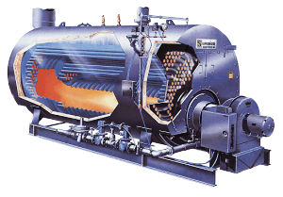
Energy Efficiency in Boiler & Combustion Techniques
M. JOEL FRANKLIN ASARIA
Sr. Deputy Director
NPC
1

Slide 2
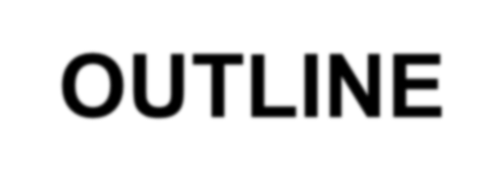
OUTLINE
Introduction
Types & Classification
Boiler System
Assessment of a Boiler
Combustion
Energy Efficiency Opportunities
2

Slide 3
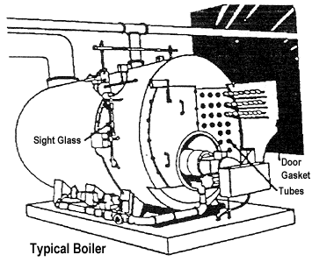
Introduction to Boiler
It is an enclosed Pressure Vessel
Heat generated by Combustion of Fuel is transferred to water to become steam
Process: Evaporation
Steam volume increases to 1,600 times from water and produces tremendous force
Care is must to avoid explosion
What is a boiler?
Notes:
The Indian Boilers Act 1923
Amendment in 2007
25 litrs and above 1 kg/cm2
Boiler components- steam pipe,feed pipe, super heater, economiser, any mounting internal or external
Steam pipe – 3.5 kg/cm2 or 1 inch internal thickness

Slide 4
Boiler Specification
Boiler Make & Year :XYZ & 2003
MCR(Maximum Continuous Rating) :10TPH (F & A 100ºC)
Rated Working Pressure :10.54 kg/cm²(g)
Type of Boiler :3 Pass Fire tube
Fuel Fired : Fuel Oil
Heating surface : M²

Slide 5
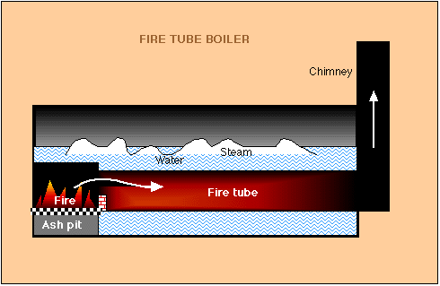
Boiler Types and Classifications
Fire in tube or Hot gas through tubes and boiler feed water in shell side
Fire Tubes submerged in water
Application
Used for small steam capacities
(up to 25T/ hr and 17.5kg/cm²⁾
Merits
Low Capital Cost and fuel Efficient (82%)
Accepts wide load fluctuations
Steam pressure variation is less
Easy to operate
Packaged Boiler
Fire Tube Boiler

Slide 6
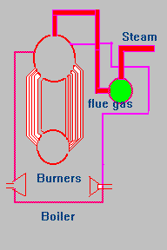
Boiler Types and Classifications
Water flow through tubes
Water Tubes surrounded by hot gas
Application
Used for Power Plants
Steam capacities range from 4.5- 120 t/ hr
Characteristics
High Capital Cost
Used for high pressure and high capacity steam boiler
Demands more controls
Calls for very stringent water quality
Water Tube Boiler

Slide 7
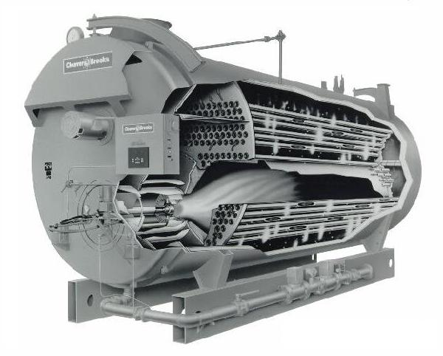
Packaged Boiler
Package boilers are generally of shell type with fire tube design
High heat release rate in small combustion space
More number of passes-so more heat transfer
Large number of small diameter tubes leading to good convective heat transfer.
Higher thermal efficiency
Notes:
It comes as a complete package. Once delivered at site, it requires only steam , water , fuel and electrical connections to become operational

Slide 8
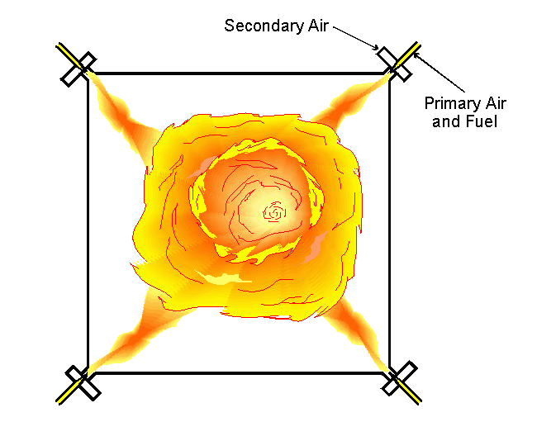
Pulverized Fuel Boiler
Coal is pulverised to a fine powder, so that less than 2% is +300 microns, and 70-75% is below 75 microns.
Coal is blown with part of the combustion air into the boiler plant through a series of burner nozzles.
Combustion takes place at temperatures from 1300-1700°C
Particle residence time in the boiler is typically 2-5 seconds
One of the most popular system for firing pulverized coal is the tangential firing using four burners corner to corner to create a fire ball at the center of the furnace.
Tangential firing
Notes:
Most coal fired power station boilers use Pulverised coal

Slide 9
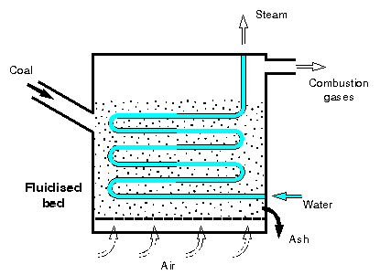
Fluidized bed Combustion (FBC) boiler
When an evenly distributed air or gas is passed upward through a finely divided bed of solid particles such as sand supported on a fine mesh, the particles are undisturbed at low velocity. As air velocity is gradually increased, a stage is reached when the individual particles are suspended in the air stream
Further, increase in velocity gives rise to bubble formation, vigorous turbulence and rapid mixing and the bed is said to be fluidized.
Coal is fed continuously in to a hot air agitated refractory sand bed, the coal will burn rapidly and the bed attains a uniform temperature
Fluidized Bed Combustion

Slide 10
Fluidised Bed Combustion

Slide 11
Fluidized-bed boiler (Contd..)
Advantages :
Higher rates of heat transfer between combustion process and boiler tubes (thus reduced furnace area and size required), Compact design
combustion temperature 850ºC is lower than in a conventional furnace. The lower furnace temperatures means reduced NO_{x} production.
In addition, the limestone (CaCO₃) and dolomite (MgCO₃) react with SO₂ to form calcium and magnesium sulfides, respectively, solids which do not escape up the stack; This means the plant can easily use high sulfur coal.
Fuel Flexibility: Multi fuel firing

Slide 12
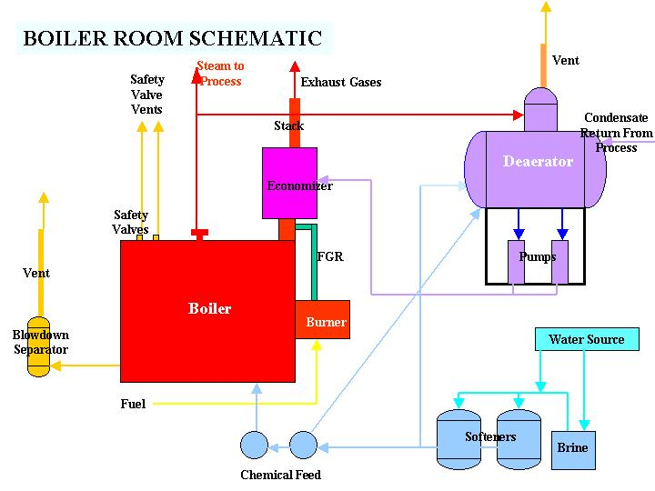
Boiler Systems
Water treatment system
Feed water system
Steam System
1
Blow down system
Fuel supply system
Air Supply system
Flue gas system
Notes:
The boiler system comprises of

Slide 13
Thermic Fluid Heaters
At high temperatures, steam requires a corresponding high operating pressure and establishing high temperatures with steam can be very cumbersome and expensive in some cases.
In thermic fluid heaters, a special type of oil-synthetic / mineral -is used as heat carrier. This fluid can be heated up to 300ºC at atmospheric pressure. In comparison steam would require a pressure of 85 bars to obtain this temperature.
Advantages:
High temperature operation at atmospheric pressure
Optional temperature level set points
No supply or treatment of hot water and hence no heat loss due to condensate flash steam
No risk of corrosion
Easy to operate

Slide 14
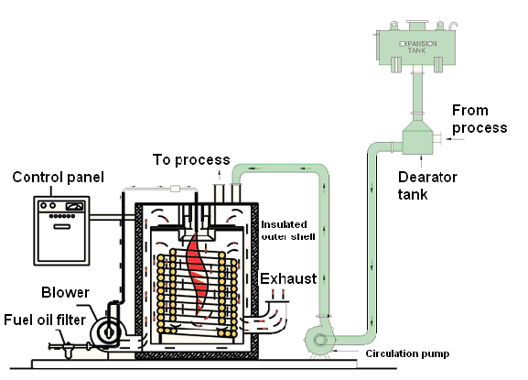
Thermic Fluid Heater

Slide 15
Assessment of a Boiler
BOILER PERFORMANCE
Causes of poor boiler performance
-Poor combustion
-Heat transfer surface fouling
-Poor operation and maintenance
-Deteriorating fuel and water quality
Heat balance: identify heat losses
Boiler efficiency test: helps to determine
deviation from best efficiency
13
Notes:
Efficiency reduces with time, due to poor combustion, heat transfer fouling and poor operation and maintenance. Deterioration of fuel and water quality also leads to poor performance of boiler.

Slide 16
Assessment of a Boiler
HEAT BALANCE
An energy flow diagram describes graphically how energy is transformed from fuel into useful energy, heat and losses
Stochiometric Excess Air
Un burnt
Stack Gas
FUEL INPUT
STEAM OUTPUT
Convection & Radiation
Blow Down
Ash and Un-burnt parts of Fuel in Ash
14

Slide 17
Assessment of a Boiler
HEAT BALANCE
Balancing total energy entering a boiler against the energy that leaves the boiler in different forms
BOILER
12.7 %
Heat loss due to dry flue gas
8.1 %
Heat loss due to steam in fuel gas
100.0 %
Fuel
1.7 %
Heat loss due to moisture in fuel
0.3 %
Heat loss due to moisture in air
2.4 %
Heat loss due to unburnts in residue
1.0 %
Heat loss due to radiation & other unaccounted loss
73.8 %
Heat in Steam

Slide 18
Assessment of a Boiler
HEAT BALANCE
Goal: improve energy efficiency by reducing
avoidable losses
Avoidable losses include:
Stack gas losses (excess air, stack gas temperature)
Losses by unburnt fuel
Blow down losses
Condensate losses
Convection and radiation

Slide 19
Assessment of a Boiler
BOILER EFFICIENCY
Thermal efficiency: % of (heat) energy input that is effectively utilised to generate steam
BOILER EFFICENCY
CALCULATION
2) INDIRECT METHOD:
The efficiency is the different between losses and energy input
1) DIRECT METHOD:
The energy gain of the
working fluid (water and steam) is compared with the energy content of the boiler fuel.
17
Notes:
Thermal eff of a boiler is defined as

Slide 20
Assessment of a Boiler
BOILER EFFICIENCY: DIRECT METHOD
Heat Output
Heat Input
Q x (hg – hf) _{x 100}
Q x GCV
Boiler efficiency (η) =
x 100 ₌
hg -the enthalpy of saturated steam in kcal/kg of steam
hf -the enthalpy of feed water in kcal/kg of water
Parameters to be monitored:
Quantity of steam generated per hour (Q) in kg/hr
Quantity of fuel used per hour (q) in kg/hr
The working pressure (in kg/cm2(g)) and superheat temperature (oC), if any
The temperature of feed water (oC)
Type of fuel and gross calorific value of the fuel (GCV) in kcal/kg of fuel

Slide 21
Assessment of a Boiler
Evaporation ratio monitoring is best suited for any boiler when its own performance is compared on day to day basis as a performance indicator; given that enthalpy gain in steam and fuel calorific value remain constant.
A drop in evaporation ratio indicates a drop in Boiler efficiency.
Evaporation Ratio (Steam-Fuel consumption ratio)
= Feed water consumption (kg/hr)
Fuel consumption (kg/hr)
Type of fuel | Typical Evaporation Ratio
Fuel oil Solid fuel Gaseous fuel | ~ 13–14 kg steam/kg fuel oil ~ 4–5 kg steam/kg solid fuel ~ 13 kg steam/Nm³ gaseous fuel

Slide 22
Assessment of a Boiler
BOILER EFFICIENCY: DIRECT METHOD
Advantages
Quick evaluation
Few parameters for computation
Few monitoring instruments
Easy to compare evaporation ratios with benchmark
figures
Disadvantages
No explanation of low efficiency
Various losses not calculated
Notes:
Evaporation ration is steam generated to fuel consumed ratio

Slide 23
Efficiency Calculation by Direct Method
Example:
Type of boiler: Coal fired Boiler
Heat input data
Qty of coal consumed :1.8 TPH
GCV of coal :3200K.Cal/kg
Heat output data
Qty of steam gen : 8 TPH
Steam pr/temp :10 kg/cm²(g)/180⁰C
Enthalpy of steam(sat) at 10 kg/cm²(g) pressure :665 KCal/kg
Feed water temperature : 85⁰ C
Enthalpy of feed water : 85 KCal/kg
Find out the Find efficiency ?
Find out the Evaporation Ratio?

Slide 24
Boiler efficiency (η): = Q x (H – h) x 100
(q x GCV)
Where Q = Quantity of steam generated per hour (kg/hr)
H = Enthalpy of saturated steam (kcal/kg)
h = Enthalpy of feed water (kcal/kg)
q = Quantity of fuel used per hour (kg/hr)
GCV = Gross calorific value of the fuel (kcal/kg)
Boiler efficiency (η)= 8 TPH x1000Kg/Tx (665–85) x 100
1.8 TPH x 1000Kg/T x 3200
= 80.0%
Evaporation Ratio = 8 Tonne of steam/1.8 Ton of coal
= 4.4

Slide 25
Assessment of a Boiler
BOILER EFFICIENCY: INDIRECT METHOD
Efficiency of boiler (η) = 100 – (i+ii+iii+iv+v+vi+vii)
Principle losses:
Loss of heat due to dry flue gas
Loss of heat due to evaporation of water formed due to H₂ in fuel
Loss of heat due to evaporation of moisture in fuel
Loss of heat due to moisture present in combustion air
Loss of heat due to unburnt in fly ash
Loss due to unburnt in bottom ash
Loss due to radiation and other unaccounted losses

Slide 26
Assessment of a Boiler
BOILER EFFICIENCY: INDIRECT METHOD
Required calculation data
Ultimate analysis of fuel (H2, O2, S, C, moisture
content, ash content)
% oxygen or CO2 in the flue gas
Fuel gas temperature in ◦C (Tf)
Ambient temperature in ◦C (Ta) and humidity of air in
kg/kg of dry air
GCV of fuel in kcal/kg
% combustible in ash (in case of solid fuels)
GCV of ash in kcal/kg (in case of solid fuels)

Slide 27
Assessment of a Boiler
BOILER EFFICIENCY: INDIRECT METHOD
Solution :
Theoretical air requirement
Actual mass of air supplied/ kg of fuel (AAS) = {1 + EA/100} x theoretical air

Slide 28
Assessment of a Boiler
BOILER EFFICIENCY: INDIRECT METHOD
m = mass of dry flue gas in kg/kg of fuel
C_{p} = Specific heat of flue gas (0.23 kcal/kg ⁰C)

Slide 29
Assessment of a Boiler
BOILER EFFICIENCY: INDIRECT METHOD
ii. Percentage heat loss due to evaporation of water formed due to H₂ in fuel

Slide 30
Assessment of a Boiler
BOILER EFFICIENCY: INDIRECT METHOD
iii. Percentage heat loss due to evaporation of moisture present in fuel

Slide 31
Assessment of a Boiler
BOILER EFFICIENCY: INDIRECT METHOD

Slide 32
Assessment of a Boiler
BOILER EFFICIENCY: INDIRECT METHOD

Slide 33
Assessment of a Boiler
BOILER EFFICIENCY: INDIRECT METHOD
In a relatively small boiler, with a capacity of 10 MW, the radiation and unaccounted losses could amount to between 1% and 2% of the gross calorific value of the fuel
while in a 500 MW boiler, values between 0.2% to 1% are typical.

Slide 34
Assessment of a Boiler
BOILER EFFICIENCY: INDIRECT METHOD
ADVANTAGES
Complete mass and energy balance for each
individual stream
Makes it easier to identify options to improve boiler efficiency
DISADVANTAGES
Time consuming
Requires lab facilities for analysis

Slide 35
Assessment of a Boiler
BOILER BLOW DOWN
Controls ‘total dissolved solids’ (TDS) in the water that is boiled
Blows off water and replaces it with feed water
Conductivity measured as indication of TDS levels
Calculation of quantity blow down required:
Feed water TDS x % Make up water
Maximum Permissible TDS in Boiler water
Blow down (%)
=

Slide 36
Assessment of a Boiler
BOILER BLOW DOWN
Two types of blow down
Intermittent
Manually operated valve
Substantial heat loss
Continuous
Ensures constant TDS and steam purity
Heat lost can be recovered
Common in high-pressure boilers

Slide 37
Assessment of a Boiler
BOILER FEED WATER TREATMENT
Quality of steam depend on water treatment to control
Steam purity
Deposits
Corrosion
Efficient heat transfer only if boiler water is free from deposit-forming solids

Slide 38
Assessment of a Boiler
BOILER FEED WATER TREATMENT
Deposit control
To avoid efficiency losses and
reduced heat transfer
Hardness salts of calcium and
magnesium
Alkaline hardness: removed by boiling
Non-alkaline: difficult to remove
Silica forms hard silica scales

Slide 39
Assessment of a Boiler
BOILER FEED WATER TREATMENT
Internal water treatment
Chemicals added to boiler to prevent scale
Different chemicals for different water types
Conditions:
Feed water is low in hardness salts
Low pressure, high TDS content is tolerated
Small water quantities treated
•
Internal treatment alone not recommended

Slide 40
Assessment of a Boiler
BOILER FEED WATER TREATMENT
External water treatment:
Removal of suspended/dissolved solids and dissolved gases
Pre-treatment: sedimentation and settling
First treatment stage: removal of salts
Processes
Ion exchange
Demineralization
De-aeration
38

Slide 41
Assessment of a Boiler
EXTERNAL WATER TREATMENT
Mechanical
de-aeration
O2 and CO2 removed by heating feed water
Economical treatment process
Vacuum type can reduce O2 to 0.02 mg/l
Pressure type can reduce O2 to 0.005 mg/l
Vent
Boiler Feed Water
Spray Nozzles
Steam
Scrubber
Section
(Trays)
Storage Section
De-aerated Boiler Feed Water

Slide 42
Assessment of a Boiler
EXTERNAL WATER TREATMENT
Chemical de-aeration
Removal of trace oxygen with scavenger
Sodium sulphite:
Reacts with oxygen: sodium sulphate
Increases TDS: increased blow down
Hydrazine
Reacts with oxygen: nitrogen + water
Does not increase TDS: used in high pressure
boilers

Slide 43
Energy Efficiency Opportunities
1.
2.
Stack temperature control Feed water preheating using economizers
Combustion air pre-heating Incomplete combustion minimization Excess air control
Avoid radiation and convection heat loss
Automatic blow down control Reduction of scaling and soot losses Reduction of boiler steam pressure Variable speed control
Controlling boiler loading Proper boiler scheduling Boiler replacement
3.
4.
5.
6.
7.
8.
9.
10.
11.
12.
13.

Slide 44
Energy Efficiency Opportunities
1. Stack Temperature Control
Keep as low as possible
If >200°C then recover waste heat
2. Feed Water Preheating Economizers
Potential to recover heat from 200 – 300 ºC flue
gases leaving a modern 3-pass shell boiler
3. Combustion Air Preheating
If combustion air raised by 20°C = 1% improve thermal efficiency

Slide 45
Reduce Stack Temperature
Stack temperatures greater than 200°C indicates potential for recovery of waste heat.
It also indicate the scaling of heat transfer/recovery equipment and hence the urgency of taking an early shut down for water / flue side cleaning.
22º C reduction in flue gas temperature increases boiler efficiency by 1%

Slide 46
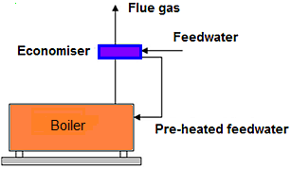
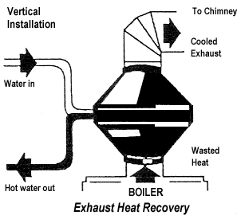
Feed Water Preheating using Economiser
For an older shell boiler, with a flue gas exit temperature of 260ºC, an economizer could be used to reduce it to 200ºC, Increase in overall thermal efficiency would be in the order of 3%.
Condensing economizer(N.Gas) Flue gas reduction up to 65ºC
6ºC raise in feed water temperature, by economiser/condensate recovery, corresponds to a 1% saving in fuel consumption

Slide 47
Energy Efficiency Opportunities
4. Minimize Incomplete Combustion
Symptoms:
Smoke, high CO levels in exit flue gas
Causes:
Air shortage, fuel surplus, poor fuel distribution
Poor mixing of fuel and air
Oil-fired boiler:
Improper viscosity, worn tops, cabonization on dips, deterioration of diffusers or spinner plates

Slide 48
Energy Efficiency Opportunities
Combustion Control
TIME
All combustion requires sufficient Time which depends upon type of Reaction
TEMPERATURE
Temperature must be more than ignition temperature
TURBULENCE
Proper turbulence helps in bringing the fuel and air in intimate contact and gives them enough time to complete reaction.

Slide 49
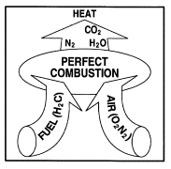
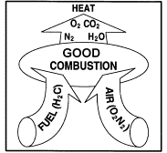
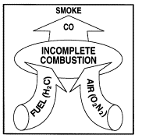
Energy Efficiency Opportunities
Combustion Reactions

Slide 50
Fouling, Scaling and Soot
Fouling or scaling- Water side
Act as insulators and reduces heat transfer resulting in higher flue gas temperature
Higher flue gas temperatures at constant steam demand and excess air level
Water treatment has to be improved-Improve water softening and maintaining lower total dissolved solids (TDS) through injecting chemicals into boiler feed water and adopting proper boiler blowdown
Soot- Fire side
Act as insulators and reduce heat transfer resulting in higher flue gas temperature
Burner is defective or air supply is insufficient.
Surfaces should be cleaned of soot periodically
Repair the burner and fine-tune the combustion system.

Slide 51
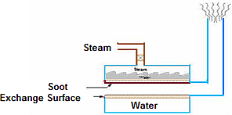
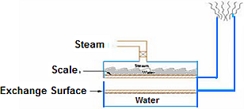
Fouling and Scaling of Boiler Heat Transfer Surface
Scale formation
Soot formation
Every 1 millimeter of scale consumes higher 2% of fuel than usual
every 1 millimeter of soot will consume much more fuel around 15-20%.

Slide 52
Energy Efficiency Opportunities
5. Excess Air Control
Excess air required for complete combustion
Optimum excess air levels varies
1% excess air reduction = 0.6% efficiency rise
Portable or continuous oxygen analyzers
Fuel0 | % theoretical CO₂ (dry basis max.) | Target CO₂% | Target O₂ | % Excess Air
Coal | 18.6 | 12.0 | 7.4 | 54
Fuel Oil | 16.0 | 13.0 | 3.9 | 23
Natural Gas | 11.7 | 10.0 | 3.1 | 17
LPG | 14.0 | 12.0 | 3.0 | 17

Slide 53
Energy Efficiency Opportunities
Draft
Natural Draft
It is the draft produced by a chimney alone. It is caused by the difference in weight between the column of hot gas inside the chimney and column of outside air of the same height and cross section
Balanced Draft
Forced-draft (F-D) fan (blower) pushes air into the furnace and an induced-draft (I-D) fan draws gases into the chimney thereby providing draft to remove the gases from the boiler
Induced Draft
An induced-draft fan draws enough draft for flow into the furnace, causing the products of combustion to discharge to atmosphere
Forced Draft
The Forced draft system uses a fan to deliver the air to the furnace, forcing combustion products to flow through the unit and up the stack

Slide 54
Excess air Formula
O₂ = percentage of oxygen content in flue gas

Slide 55
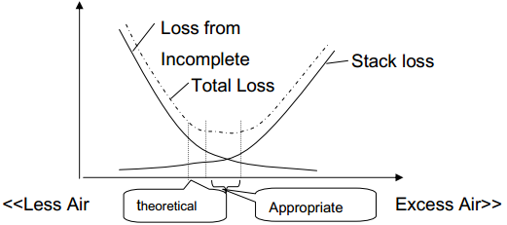
Excess Air Vs Loss

Slide 56
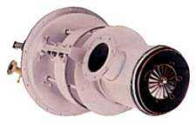
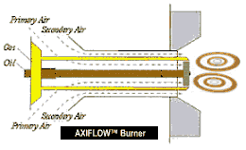
Low Excess Air Burner
Older burners require more excess air for combustion
Low excess air burners not only operate with low excess air but improve combustion efficiency as well

Slide 57
Flue Gas Loss
High excess air high flue gas loss
Insufficient air-incomplete combustion and soot built-up
Excess air norm- 10-15% (2-3% O₂)
Type of Fuel | Oxygen (%) | Carbon dioxide (%) | Carbon monoxide (ppm) | Excess air (%)
Liquid fuel | 3–4 | 12–14 | <200 | 10–20
Gas fuel | 1–2 | 9–10 | <200 | 10–20
Solid fuel | 12–13 | 12–13 | <200 | 50–70

Slide 58
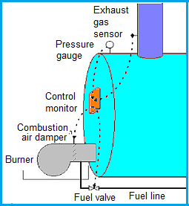
Oxygen Trim System
Monitors Oxygen level in flue gas and automatically adjusts the air-to-fuel ratio for maximum combustion efficiency
Oxygen level and excess air in flue gas kept optimum at all loads
Reduces energy consumption by 1.5–2.0%
Payback period less than 3 years
Notes:
High draft – High excess air
Damper between boiler and stack automatically controls the draft by opening or closing the damper depending on the feedback from O₂ (excess air) level

Slide 59
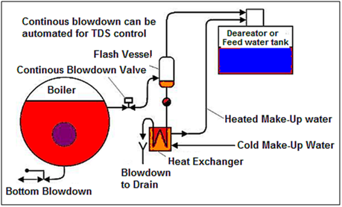
Energy Efficiency Opportunities
Radiation and Convection Heat Loss Minimization
Fixed heat loss from boiler shell, regardless of
boiler output
Repairing insulation can reduce loss
Automatic Blow Down Control
Sense and respond to boiler water conductivity
and pH

Slide 60
Energy Efficiency Opportunities
Scaling and Soot Loss Reduction
Every 22ºC increase in stack temperature = 1%
efficiency loss
3 mm of soot = 2.5% fuel increase
9. Reduced Boiler Steam Pressure
Lower steam pressure
Recommended steam pressure = Maximum pressure required + Pressure drop in the system
Steam generation pressure dictated by process
Notes:
High pressure steam ---high fuel combustion
Boiler steam pressure should be based on the temperature required in the heating process
Not on steam pressure that can be generated in boiler
Reset steam pressure in boiler to match with the actual steam load requirements to save energy

Slide 61
Benefits of Low-pressure Steam
Latent heat for condensing steam is higher at lower pressure
Steam dryness ratio will increase resulting in increase in energy in steam
Steam loss from pipes will be lower at lower steam pressure
Heat loss at boiler surface and steam distribution system will be less at lower steam pressure
Blowdown loss will be less at lower steam pressure
Fuel consumption will be lower for the same amount of steam generation

Slide 62
Energy Efficiency Opportunities
Variable Speed Control for Fans, Blowers and Pumps
Suited for fans, blowers, pumps
Should be considered if boiler loads are variable
Control Boiler Loading
Maximum boiler efficiency: 65-85% of rated load
Significant efficiency loss: < 25% of rated load

Slide 63
Energy Efficiency Opportunities
Proper Boiler Scheduling
Optimum efficiency: 65-85% of full load
Few boilers at high loads is more efficient than large number at low loads
Boiler Replacement
Financially attractive if existing boiler is
Old and inefficient
Not capable of firing cheaper substitution fuel
Over or under-sized for present requirements
Not designed for ideal loading conditions
Notes:
Since boiler plants traditionally have a useful life of well over 25 years, replacement must be carefully studied.

Slide 64
Energy Auditing Approach for Boiler
Data and Information
Collect boiler details: type, rated steam pressure, temperature, and steam capacity.
Collect feed water pump details: type, no. of stages, flow, and pressure.
Record allowable TDS in boiler.
Collect FD/ID fan flow, pressure, motor rating, kW.
Collect burner details: type, rated temperature, pressure, turndown ratio.
Collect supply and return thermic fluid temperature.
Assess thermic fluid loads (temperature, flow).

Slide 65
Energy Auditing Approach for Boiler
Instruments and Measurements
Flue gas analyser
Thermocouple
Contact thermometer
Hygrometer

Slide 66
Energy Auditing Approach for Boiler and Thermic Fluid Heater System
Field Audit
Examine the boiler/thermic fluid log book.
Review operating steam/thermic fluid pressure.
Review operating steam temperature and thermic fluid temperatures.
Review steam production records.
Measure steam/thermic fluid flows through meters. Steam flow can be indirectly through feed water meter or from level measurements in overhead tank.
Review fuel consumption records and check fuel (oil) consumption by measuring difference in fuel oil tank level.
Measure gas measurement through gas meter.
Review make-up water records.
Check condensate return, quantity, and temperature.

Slide 67
Energy Auditing Approach for Boiler and Thermic Fluid Heater System
Measure feed water temperature.
Measure O₂, CO₂ percent in exhaust flue gas, CO level in ppm.
Measure oil pre-heat temperature and pressure.
Review Allowable TDS in boiler and TDS in blowdown.
Measure O₂ level before and after heat recovery equipment like economiser, air pre-heater.
Check insulation of feed water tank (measure surface temperature and calculate heat losses).
Prepare schematic of water treatment system.
Review feed water and make-up water testing procedures.

Slide 68
Energy Auditing Approach for Boiler and Thermic Fluid Heater System
Analysis
Assess steam-fuel ratio (Evaporation Ratio).
Assess efficiency by direct method/indirect method.
Compare excess air levels against desirable levels.
Check whether oil pre-heating is adequate.
Check condition of fuel firing equipment (burner, coal grate).
Review flue gas temperature trend over last few months.
Conduct mass and energy balance of boiler system including blowdown.
Evaluate scope for waste heat recovery.

Slide 69
Energy Auditing Approach for Boiler and Thermic Fluid Heater System
Report
Description of boiler system.
Description of water treatment system.
Generate energy saving opportunities
(scope for reducing excess air and flue gas loss, scope for heat recovery using blowdown, scope for using alternative renewable fuel like say biomass, scope for replacing old boiler (> 25 years) with modern energy efficient boiler)

Slide 70
Thank you

