Slide 1
SOLAR THERMAL BOILER OPERATION, PERFORMANCE AND CASE Study
Concentrating Solar Process Steam Plant

Slide 2
INTRODUCTION
Using technology to harness solar energy reached a tripping point and from that try to get all about optimized product with comprehensive financial package.
Tie up with 16 modules of protarget’s CF100 parabolic trough collectors is equipped with CF115 receiver tubes and employs a new , environmental friendly, silicone heat transfer fluid Helicol 5a with multi layer solar selective coating which has an absorptance of more than 93% and an emittance of circa 15% at 350⁰C that gives an edge in providing flawless engineering and design solutions. It emphasis towards maximum longevity, reliability and efficiency
Applicable to industry like food processing, mining, oil, textile & leather, Cement & ceramic, paper, Pharmaceutical & chemical, plastic & rubber, dairies & bakeries, slaughter house, wineries, breweries, distilleries, hotel & tourism.
Sun is the most abundant and least expensive source of energy available in the Universe. From that energy autonomy to the particular company, usable for process heating, cooling, air conditioning and desalination can be achieved at minimum planning and logistics overheads and at low energy generation, O & M, and fuel cost.

Slide 3
Principle
Steam is produced using solar thermal technology which is equivalent to that of burning of class concentrating the solar heat at a focal point.
Achieved by using concave mirrors having 4 mm thickness Flabeg F750 glass focusing the sun light on a tube containing a heat transfer fluid which can be heated up to 400⁰ C and then used to generate steam in a shell type boiler with pressure up to 20 kg/sq.cm with temperature of 210⁰ C that have been proven in service for more than 30 years in accordance with ISO 9050 using the ASTM G173 direct spectrum. The complete solar collector has been qualified by the German Aerospace Centre and the German TUV.
The capacity modularly expanded in steps of 0.25 MW. The peak load output of the plant is predicted to be 300 KW, given direct normal solar irradiation (DNI) of 900 W/Sq.m, with a nominal output of 250 kW at a DNI of 750 W/sq.m.
Can be equipped with gas or oil for hybrid operation.
Minimum mirror cleaning cost
Virtually loss free heat storage system ensures night or bad whether operation.
Automatic focusing of sun light with proper tracking arrangements.

Slide 4


Slide 5
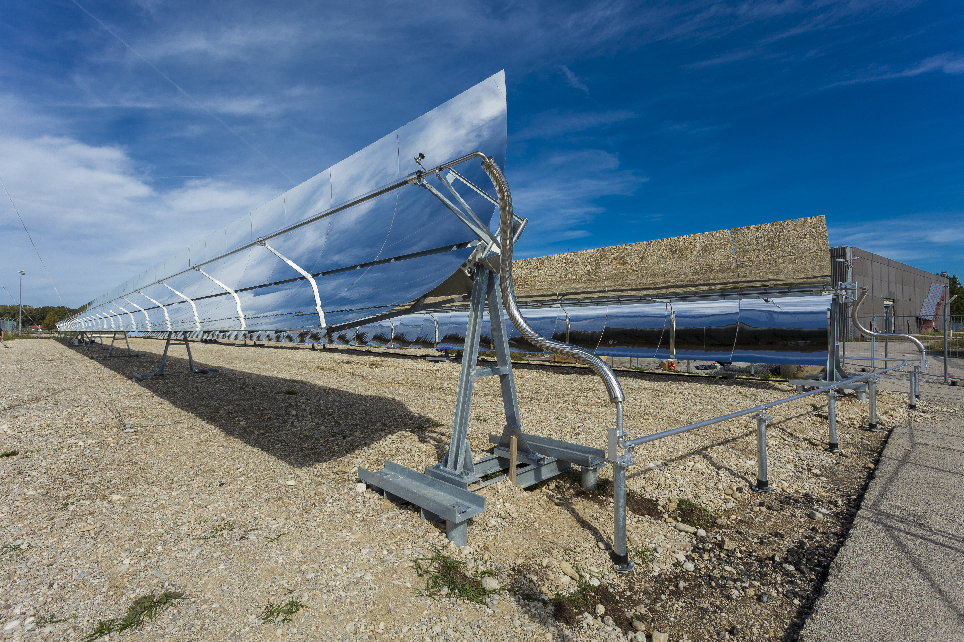

Slide 6
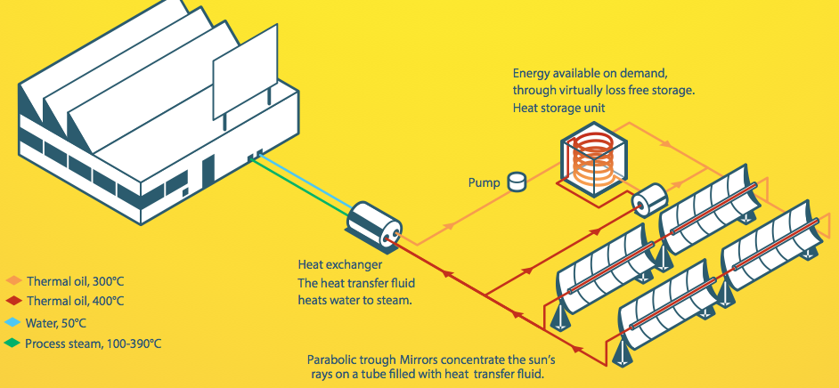

Slide 7
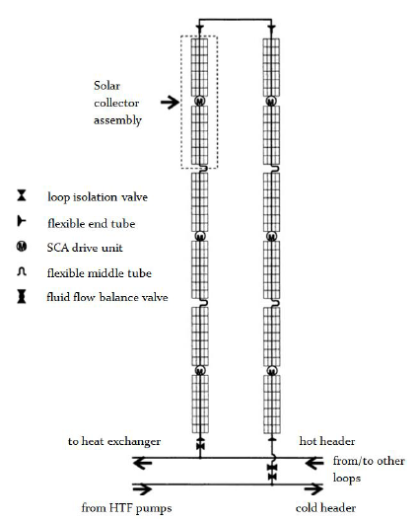
Technical parameters
Thermal oil temperature 270°C.
Steam output temperature 216°C at 20 bar.
334 kg/hr with total yield of 670 tonnes of steam in a typical year.
Economic factors
Total cost =1.62 Crore
(promoter 52 lacs and a loan from IRDEA of 110 lacs)
Sale of energy in the form of steam at an average monthly income of Rs. 81,000 /month
220°C
270°C

Slide 8
Technical DETAILS
The plant contains
a) Solar field with parabolic trough collectors (PTC) including pumps, piping and controls.
b) Solar Steam generator heated by thermal oil and its auxiliary equipments
c) Operating area with switch panels with utility equipments.
Site details containing Latitude, Longitude, and its elevation.
Proposed capacity such that this project is as nominal power output of the collector 250 kW measured when the plant is receiving 750 W/sq.meter of DNI and the plant is rated peak thermal output of 300 kW when DNI is 900 W/sq.meter.
Energy produced per year is when DNI 1785 kWh /sq.meter the Concentrating Solar field will produce a net yield of 520 MWh of thermal energy which will be transformed into steam at the pressure of 20.6 bar G and at 216⁰C. This was developed in collaboration with DLR ( German Aerospace Research Centre).
All the products are backed with Performance Guarantee and are TUV certified.
Levelized Cost of steam as low as Rs.0.50.

Slide 9
Technical details follows
Expected life time of entire solar field is 25 years.
Prefabricated mid sized parabolic trough collector called CF100 is suited for the application at industrial facilities with the need of steam with the temperatures between 100⁰C and 350⁰C which is qualified by the DLR Test and Qualification Centre for Concentrating Solar Power Technologies designed in accordance with relevant European regulations. Number of rows as two with 16 numbers modules with Nominal aperture area is 560 sq.meter and with Nominal mirror area is as 630 sq.meter.
Receiver tube type is Silicone – Helisol 5a
Steam boiler – shell and tube heat exchanger type by three rows of coil through which the heated thermal oil at 270⁰C is passed. The oil outlet temperature is 220⁰C after giving the heat to the water to produce steam of having 216⁰C at 20.6 bar G.
Steam output is 334 kg/h in nominal and 400 kg/h in peak when DNI 750 W/sq.meter and 900 W/sq.meter recovered from parabolic plate respectively.

Slide 10
Solar thermal project
300kW solar thermal project delivering 350 kg high pressure steam per hour for milk drying processing.
Business model on RESCO mode with a EPA (energy purchase agreement) at Rs. 1.2 per kg of steam
State of an art engineering integration with the existing boiler.
System capable of producing two tons of steam per day.

Slide 11
Features of our technology
Provide temperature range from 70°C – 390°C
System designed to last at least 30 years.
Thermal Storage option available for 24 hour operation.
Cost of steam as low as Rs. 1/kg as compared to coal at Rs. 1.3/Kg.
Environment friendly thermal fluid.
O&M includes maintenance of parts such as pumps, heat exchangers, etc. which are regularly used in boiler house.
Seamless integration with existing boilers.

Slide 12
Target Industries
Oil & Gas processing.
Pharmaceutical industry.
Dairy sector.
Textiles processing.
Mining sector for mid temperature application.
Plastics and rubber industries.
Wineries, Breweries and Distilleries.
Chemical industries for process heat and Zero Liquid Discharge.
Zero Liquid Discharge for all industries.

Slide 13
Zero Liquid Discharge systems
Demonstrating Solar Thermal based Zero Liquid Discharge systems is in partnership with Bharat Oman Refineries Limited using solar thermal technology in combination with ‘Membrane Distillation systems’.
Our ZLD systems are made of Poly Propylene (PP). Hence, corrosion is not an issue.
Negligible cost of maintenance.
Ideal for industries with hot effluent discharge as the operating costs would be much lower than pressure driven processes such as Reverse Osmosis (RO) process.
Modular system with long life.

Slide 14
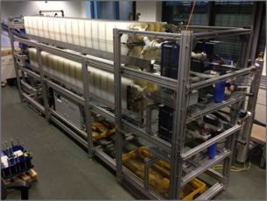
Membrane Distillation System

Slide 15
Advantages
These business models are offered with in-built financial models.
Financing options include interest rates as low as 5% per annum.
Only the technology providers giving Performance Guarantee with these system.
Various options of business models such as RESCO (Renewable Energy Service Company) wherein no upfront cost is incurred on the client.
Original philosophy is “German Engineering at Indian Cost” through the robust supply chain built in India on German manufacturing standards.

Slide 16
THANK YOU

