Slide 1
Energy Auditing of Fan System

Slide 2
Centrifugal Fan Applications
Supplying combustion air
Discharging flue gases
Transporting materials
Ventilating buildings

Slide 3
Fan Types
Notes:
Efficient distribution of conditioned air needed to heat, cool, and ventilate a building requires the service of a properly selected and applied fan.
The types of fans commonly include centrifugal and axial designs.
In a centrifugal fan the airflow follows a radial path through the fan wheel.
In an axial fan the airflow passes straight through the fan, parallel to the shaft.

Slide 4
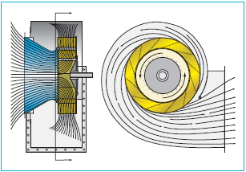
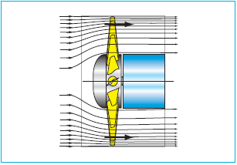
Flow in Centrifugal fan
Flow in Axial fan
Notes:
In a centrifugal fan the airflow enters the center of the fan from the side and follows a radial path through the fan wheel.
There are three principal types of centrifugal fans, each distinguished by the type of fan wheel used: forward curved (FC), backward inclined (BI), and airfoil (AF).

Slide 5
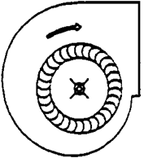
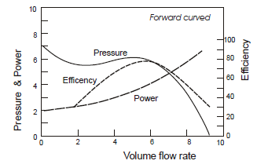
Centrifugal -Forward Curved
Blades curved in the direction of rotation
Low efficiency (between 50−65%)
Small and compact
Lower airflow, lower static pressure, lower first cost
Clean air applications-HVAC
Notes:
FC fans are operated at relatively low speeds and are used to deliver large volumes of air against relatively low static pressures.
The light construction of the forward curved fan wheel does not permit this wheel to be operated at the speeds needed to generate high static pressures.
The forward curved fan is best applied in small systems requiring 20,000 cfm [9.4 m3/s] or less and static pressures of 4 in. H2O [996 Pa] or less. The FC fan is also the least costly.

Slide 6
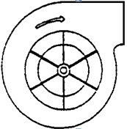
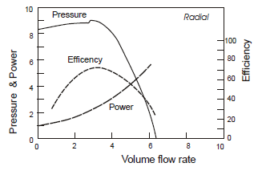
Centrifugal-Radial Bladed
Flat blade shape
Applications requiring low to medium airflow rates at high pressures
High dust level applications- Pneumatic conveying

Slide 7
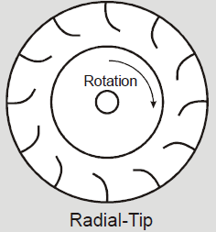
Centrifugal-Radial-tip
Less turbulence than radial bladed
More efficient than the radial blade but less than backward inclined (up to 75%)
Airstreams containing small amount of dust
Notes:
It is a improved version of radial bladed fan.

Slide 8
Centrifugal-Backward Curved
Blades curve tilt away from direction of rotation
Higher speed than Forward curved fans
Most efficient fan (65-75%)
Higher airflow, higher static pressure, higher efficiency
Large HVAC applications
Notes:
Systems requiring in excess of 20,000 cfm [9.4 m3/s] and 3 in. H2O [747 Pa] of static pressure are usually best served by the more efficient backward inclined or airfoil fans.
With larger fan sizes and larger motors, the higher fan efficiencies can result in significant energy savings.

Slide 9
Centrifugal-Backward Inclined(Airfoil)
Smooth air flow across bade surface reducing turbulence
Higher static efficiency (exceeding 85%)
Clean air applications e.g. forced-draft fans(boilers) and industrial dryer fans (furnaces)
Notes:
A refinement of the BI fan changes the shape of the blade from a flat plate to that of an airfoil, similar to an airplane wing. The airfoil blade induces a smooth airflow across the blade surface, reducing turbulence and noise within the wheel. This results in increased static efficiency and reduced overall sound levels.
Airfoil (AF) fans exhibit performance characteristics that are essentially the same as those of the flat-bladed BI fan.

Slide 10
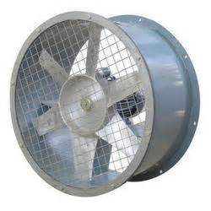
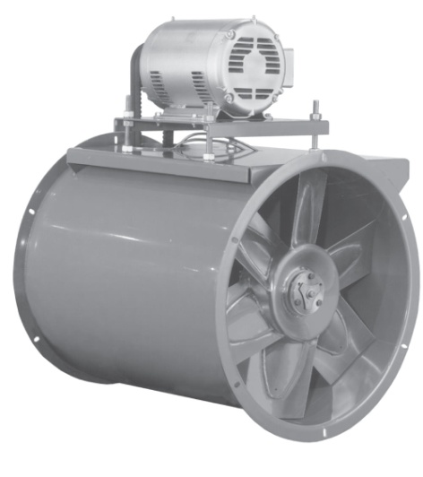
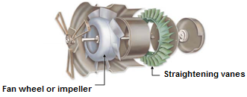
Axial Fan Types
Propeller Fan
Tube-axial Fan
70-80% efficiency
Vane-axial Fan
Notes:
In an axial fan, the airflow passes straight through the fan, parallel to the shaft. There are three common axial fan types: propeller, tubeaxial, and vaneaxial.
Propeller fans are well suited for high volumes of air, but have little or no static-pressure generating capability.
Tubeaxial and vaneaxial fans are simply propeller fans mounted in a cylinder.
They are similar except for the vane-type straighteners used in the vaneaxial design.
Since a propeller fan inherently produces a spiral air stream, these vanes are installed at the leaving side of the fan to remove much of the swirl from the air and straighten the airflow path.
These vanes improve efficiency, and reduce turbulence and the resulting sound generated in the downstream ductwork.
The straightening vanes allow for greater efficiency and pressure capabilities
Because a vaneaxial fan is more efficient than a tubeaxial fan, it can handle larger volumes of air at higher pressures.
When space is a prime consideration, the vaneaxial fan may be the best solution. Straight-through airflow permits this fan to be installed in limited space.

Slide 11
Features of Axial Fans
Compactness
Light weight
Low cost
Direct-drive units (operating at motor speed)
Belt-drive units (flexibility in fan speed selection)
Offers better efficiencies over wider range of duties

Slide 12
Applications of axial fans
Exhausting contaminated air or supplying fresh air
Unidirectional or reversible air-flow applications
Exhaust applications where airborne dust size is small, such as dust streams, smoke and steam

Slide 13
Fan Selection
Airflow
Static pressure
Temperature
Dust
Moisture
System layout
Cost
Availability
Plant personnel familiarity

Slide 14
Estimation of Airflow & Static Pressure
Airflow estimated based on user requirements
Static pressure
estimated based on pressure drops in various components:
Pipe size, length, bends, filter, equipment (e.g. waste heat recovery devise), etc. in the air flow path.

Slide 15
Static, Velocity and Total Pressures
Static Pressure
Static pressure is the pressure exerted on the duct walls.
Velocity Pressure
Velocity pressure is the kinetic energy of a unit of air flow in an air stream. It is also called as dynamic pressure. The velocity pressure depends upon both air velocity and density.
Total Pressure
Total pressure consists of sum of pressure the moving air exerts in the direction of flow (velocity pressure) and the pressure air exerts perpendicular to the air flow in the duct (static pressure).

Slide 16
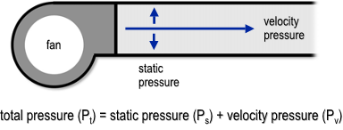
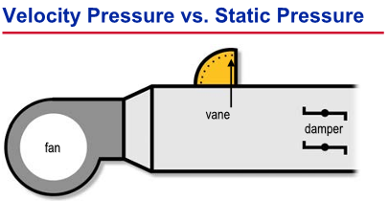

Slide 17
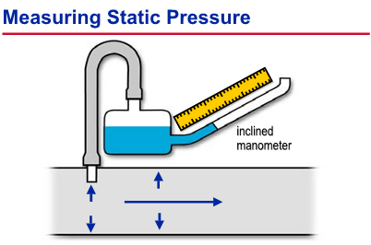
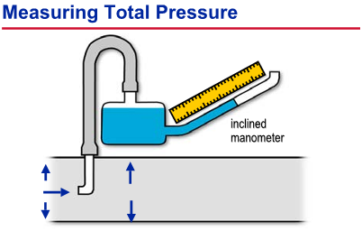
Notes:
Both velocity and static pressures can be determined using the inclined manometer. Static pressure is measured directly by inserting a probe through the duct wall with its open end perpendicular to air movement. In this position only the outward, or static, pressure within the duct is sensed.
Another probe can be placed in the duct with its open end facing into the air stream. This probe senses total pressure—the combination of velocity pressure plus static pressure.
Therefore, static pressure can be read directly, while velocity pressure is derived by subtracting the static pressure from the total pressure.
An alternate method would be to attach the open end of this manometer to the duct system, using it to measure static pressure. With one end measuring total pressure and the other end measuring static pressure, the difference read on the manometer scale would be equal to the velocity pressure.

Slide 18
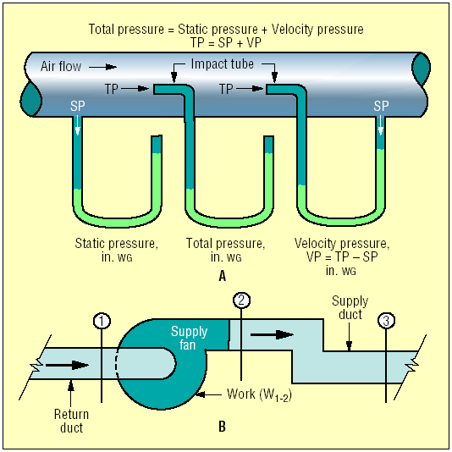
Relationship between Velocity, total and Static Pressures
P_{V} = P_{T} - P_{S}
Where,
P_{V} = Velocity Pressure
P_{T} = Total Pressure
P_{S} = Static Pressure
If velocity pressure is measured, velocity can be calculated and air flow can be determined.

Slide 19
Static Efficiency
Static efficiency
Static efficiency considers only the flow delivered against the static pressure.
e.g., the larger the diameter of fan selected, lower will be the velocity pressure with consequently lower wasted power, and higher fan static efficiency.
Notes:
The total amount of pressure generated by a fan has two components: velocity pressure and static pressure.
The velocity pressure is due to the momentum of the air as it moves axially through the duct, while the static pressure is due to the perpendicular outward “push” of the air against the duct walls.
The total pressure is the sum of the velocity pressure and the static pressure.

Slide 20
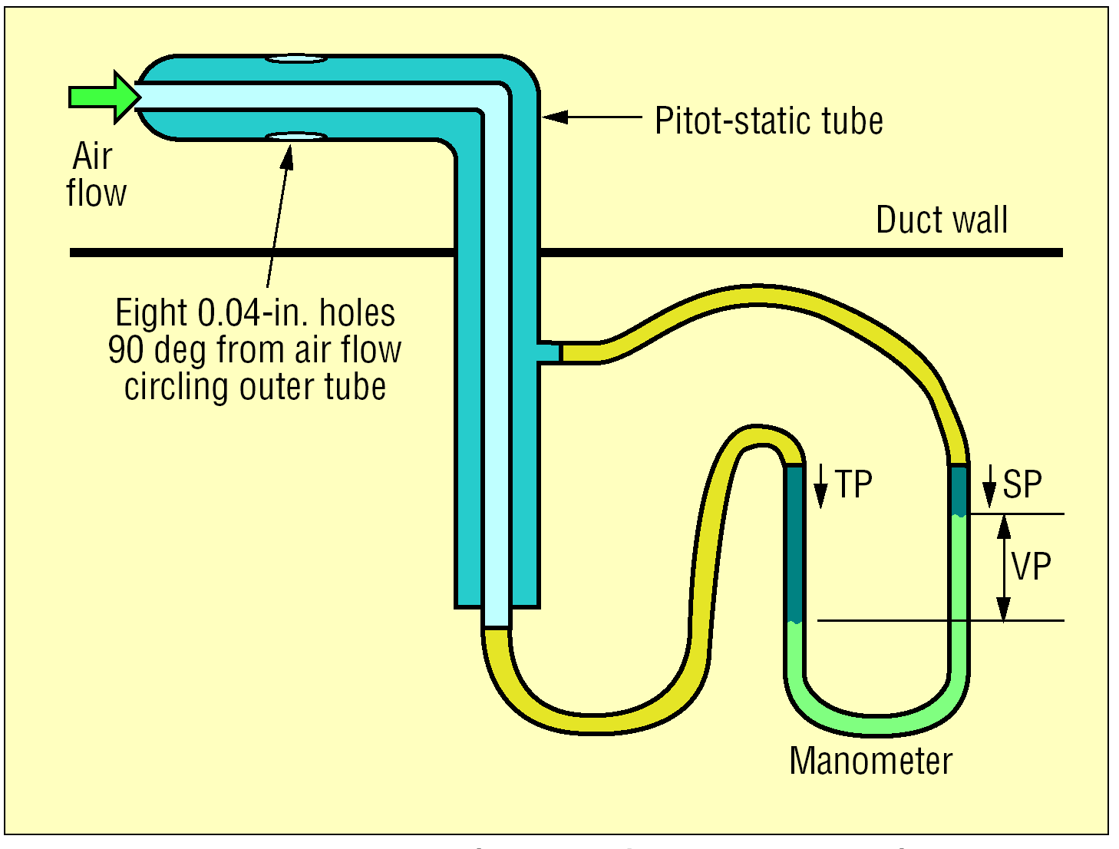

Slide 21
Calculation of Velocity and Flow rate
Average velocity = V₁ + V₂+…V_{N}
Total number of traverse points
Where V_{N} is the velocity at the Nth traverse point
Airflow (Q), m³/s = Average velocity, V (m/s) x Fan duct area (m²)
Measure flow at various operating conditions and not one flow

Slide 22
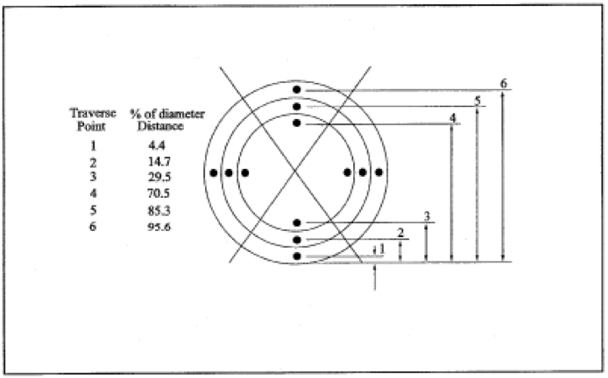
Traverse points

Slide 23
Fan Shaft Power
Fan Shaft Power, kW or
Fan Break Horse Power (BHP)
= Fan motor power, kW x Motor Efficiency, η_{m}

Slide 24
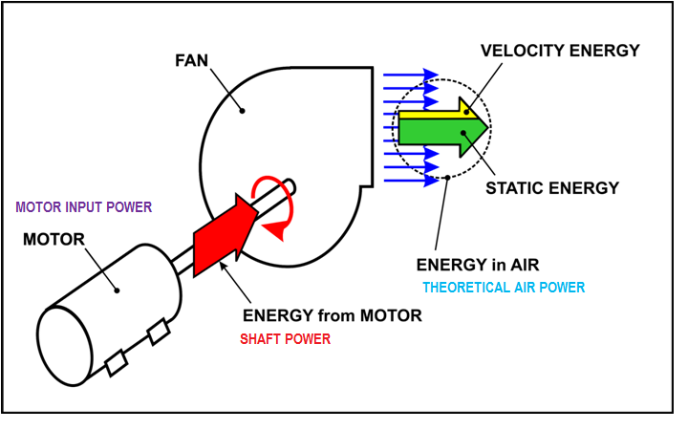

Slide 25
Fan Efficiency-Total & Static
Fan Static Efficiency η_{static}, % = Airflow in m³/s x ΔP (Static Pressure) in mmWC
102 x Fan Shaft Power in kW
ΔP (Static Pressure) = Discharge Static Pressure – Suction Static Pressure

Slide 26
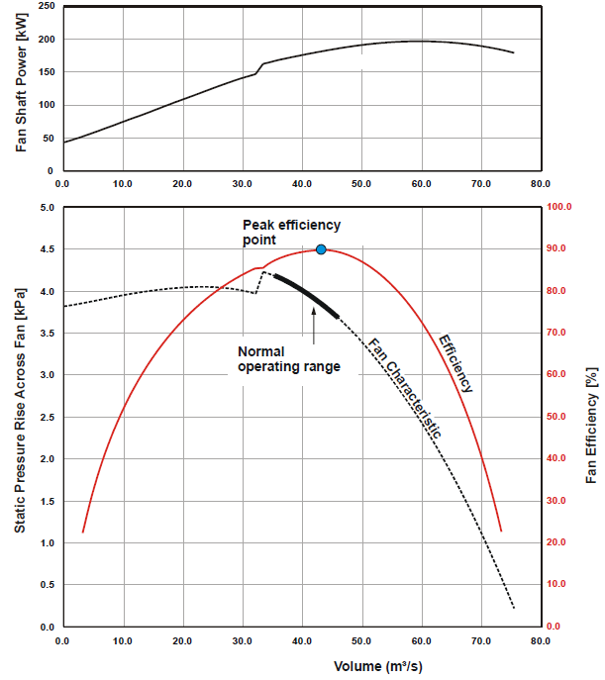
Fan
Performance
Curves

Slide 27
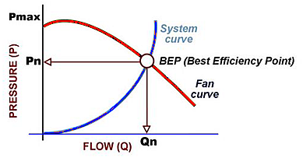
Fan System Curve
Sum of all system components:
Ductwork
Elbows
Transitions
Filters
Coils
Dampers / Louvers
Building pressure
Ps = k * CFM²
Pressure Increases with the Square of CFM!

Slide 28
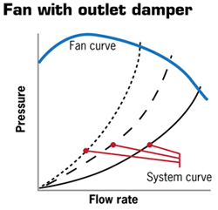
Flow Control – Discharge Damper
Throttles the air entering or leaving the fan
Control airflows in branch ducts of a fan system, or at points of delivery
Creates restriction in airflow- cause pressure drop and waste energy
More pressure drop − less flow
Notes:
Discharge Dampers
The first method to be discussed is the use of discharge dampers. Discharge dampers match the airflow and static pressure supplied by the fan with the airflow and static pressure required by the system. They accomplish this by adding a static-pressure loss to the system just downstream of the fan.

Slide 29
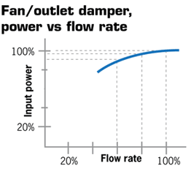
Outlet dampers have a relatively small effect on input power

Slide 30
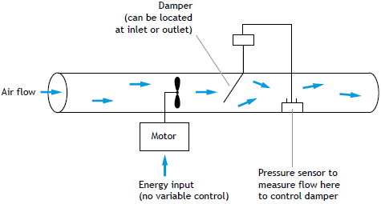
Flow Control by Outlet / Discharge Damper

Slide 31
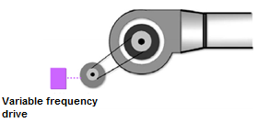
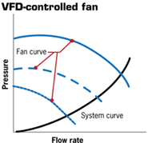
Flow Control –VFD
Close match between the fluid energy required by system and energy delivered by the fan
Uses electronic controls to regulate motor speed which in turn adjusts the fan speed to meet the demand
VFD controls the frequency of the power supplied to the motor to establish its operating speed.
Notes:
Fan-Speed Control
The third method of capacity control, fan-speed control, modulates fan capacity by varying the speed of the wheel rotation. This is commonly accomplished using a variable-speed device on the fan motor, such as a variable-frequency drive, a belt-speed changer, a variable-speed mechanical drive, or an eddy current clutch.

Slide 32
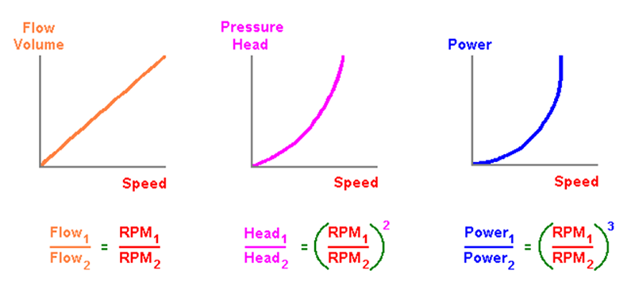
Affinity Laws

Slide 33
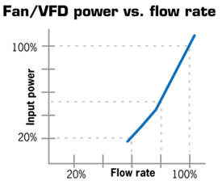
VFD closely matches the system curve and optimal input power for the desired flow

Slide 34
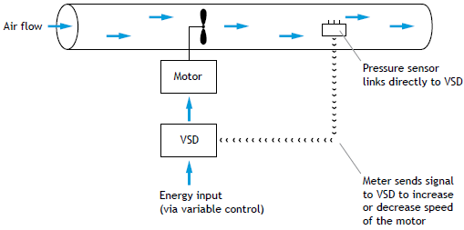
VFD Application
Data and Information
Flow and pressure requirements of the system in relation to the main business driver (e.g. production).
Fan type, make, flow rate, pressure, rated efficiency, motor rating in kW, motor efficiency, control method, drive system, pulley diameters (fan & motor) if applicable.
Production run-hours and system demand over the full range of plant operating conditions.
Other inter-related information depending upon the application (say AHU specifications, heat exchangers, driers, cooling tower capacities, combustion air requirements for boilers).

Slide 35
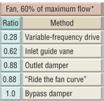
Savings with VFD instead of Damper Control
EXAMPLE
A 60-HP fan motor operates 24 hr a day, or 8,760 hr a year, “Damper control” for variable-volume control.
60 HP × 0.746 = 44.76 kW
0.88 ratio × 44.76 kW = 39.39 kW – damper control
0.28 ratio × 44.76 kW = 12.53 kW – VFD control
Savings: 39.39 kW - 12.53 kW = 26.86 kW
Annual Savings:
26.86 kw₄ × 8,760 hr × Rs. 6 per kwh =
Rs.1411761.6 (Rs. 14.1 Lakhs)

Slide 36
Fan Replacement
Fans normally oversized during design
Oversized fans deviate far from BEP
Oversized fan generate higher pressure for the same flow
Visual signs of over sizing
Almost closed dampers and inlet guide vanes
Study if entire fan-motor can be replaced OR atleast fan can be replaced

Slide 37
ENCON Opportunities in Fan Systems
Operational and Housekeeping Measures
Turn off fan when it is not needed
Check and adjust belt tension (motor-fan) regularly.
Arrest any leaks in the duct.
Clean fan blades regularly.

Slide 38
ENCON Opportunities in Fan Systems
Low-Cost Measures
Avoid damper operation through speed control (motor/fan pulley change).
Consider impeller change where applicable for fixed flow applications.
Explore use of low-slip belts such as flat, cogged belts.
Improve fan inlet and outlet duct connections to ensure proper flow distribution and losses at the inlet and outlet.

Slide 39
ENCON Opportunities in Fan Systems
Retrofit Measures
Avoid damper operation through VFD - reducing a fan’s speed by 20% can reduce its power requirements by nearly 50%.
Replacing existing fan with energy efficient fan operating closer to BEP.
Review and increase duct size if feasible. A 15% increase in duct diameter can reduce pressure drop by 50%. This allows smaller fan motor to be used.
Reduce bends in the ductwork.
Replace fan motor with energy efficient motor.
Use energy efficient aerofoil backward curved fans if feasible.

Slide 40
Thank you

