Slide 1
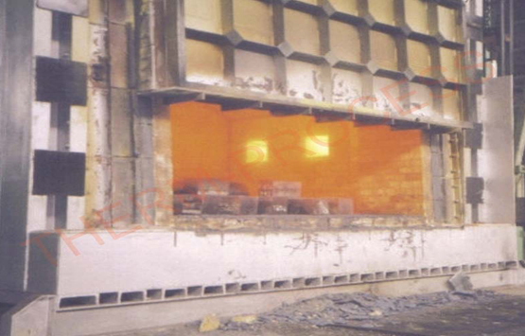
Performance Assessment of Furnace
M. Joel Franklin Asaria
Sr. Deputy Director
NPC

Slide 2
Operation Of Furnace

Slide 3
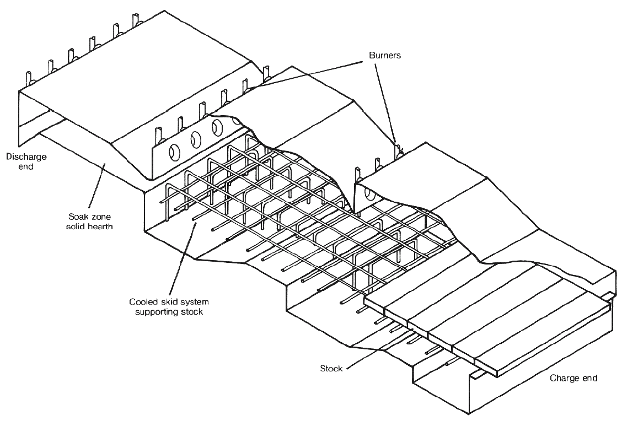
Pusher Type Furnaces

Slide 4
Forging Furnaces
Used for preheating billets and ingots to attain a ‘forge’ temperature.
The furnace temperature is maintained at 1200 to 1250ºC.
Forging furnaces, use an open fireplace system and most of the heat is transmitted by radiation.
The typical loading in a forging furnace is 5 to 6 tones with the furnace operating for 16 to 18 hours daily.
The total operating cycle can be divided into (i) heat-up time (ii) soaking time and (iii) forging time.
Specific fuel consumption depends upon the type of material and number of ‘reheats’ required.

Slide 5
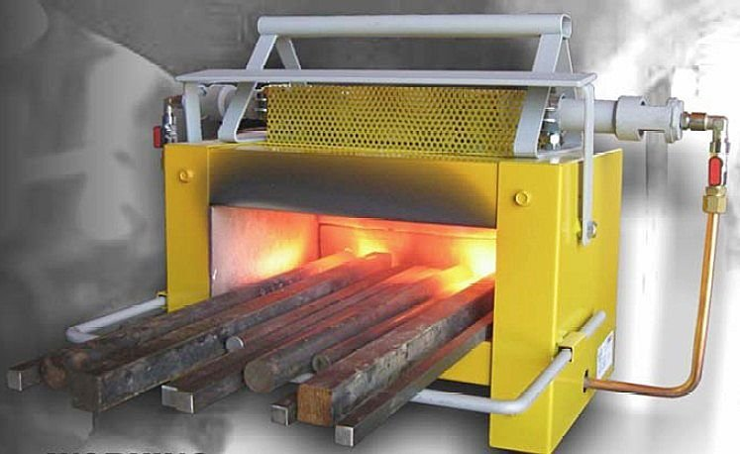
Forging Furnace

Slide 6
Heat Transfer in Furnaces
Radiation from the flame, hot combustion products and the furnace walls and roof
Convection due to the movement of hot gases over the stock surface.

Slide 7
Performance Terms and Definitions
Furnace Efficiency, η =
=
2. Specific Energy Consumption =

Slide 8
Measurement Parameters
Weight of stock / Number of billets heated
Temperature of the stocks/billets
Temperature of furnace walls, roof etc
Area of furnace walls, roof etc
Flue gas temperature
Flue gas analysis
Fuel oil consumption

Slide 9
Furnace Efficiency
The efficiency of a furnace is the ratio of useful heat output to heat input. The direct determination of furnace efficiency is carried out as follows.
The quantity of heat to be imparted (Q) to the stock can be found from the formula
Where
Q = Quantity of heat in kCal
m = Weight of the material in kg
C_{p} = Mean specific heat, kCal/kg ºC
t₂ = Final temperature desired, ºC
t₁ ₌ Initial temperature of the charge before it enters the furnace, ºC

Slide 10
Thermal Efficiencies For Common Industrial Furnaces
Furnace Type | Typical thermal efficiencies (%)
1) Low Temperature furnaces
a. 540 – 980 ºC (Batch type) | 20-30
b. 540 – 980 ºC (Continous type) | 15-25
c. Coil Anneal () radiant type | 5-7
d. Strip Anneal Muffle | 7-12
2) High temperature furnaces
a. Pusher, Rotary | 7-15
b. Batch forge | 5-10
3) Continuous Kiln
a. Hoffman | 25-90
b. Tunnel | 20-80
4) Ovens
a. Indirect fired ovens (20ºC-370ºC) | 35-40
b. Direct fired ovens (20ºC-370ºC) | 35-40

Slide 11
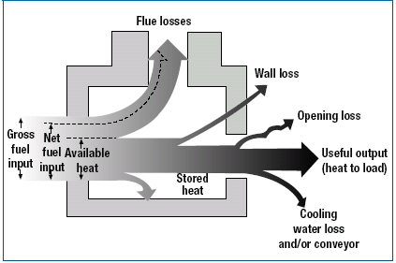
Performance Evaluation of a Typical Furnace
Heat losses in industrial heating Furnaces

Slide 12
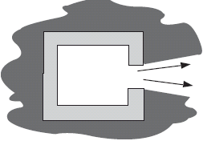
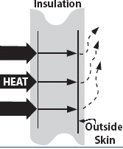
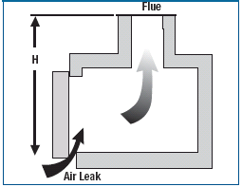
What are the furnace losses ?
Material handling loss
Cooling media losses
Radiation (opening) loss
Wall Loss:
Wall losses:
Radiation loss
Stack loss (Waste-gas loss)
Air infiltration
Stored Heat Loss:
Air infiltration from furnace opening.

Slide 13
Furnace Efficiency Calculation
Example:
An oil-fired reheating furnace has an operating temperature of around 1340ºC. Average fuel consumption is 400 litres/hour. The flue gas exit temperature after air preheater is 750ºC. Air is preheated from ambient temperature of 40 ºC to 190 ºC through an air pre-heater. The furnace has 460 mm thick wall (x) on the billet extraction outlet side, which is 1 m hight (D) and 1 m wide. The other data are as given below.
Calculate the efficiency of the furnace by both indirect and direct method.

Slide 14
Trial Data
Flue gas temperature after air preheater = 750ºC
Ambient temperature = 40ºC
Preheated air temperature = 190ºC
Specific gravity of oil = 0.92
Average fuel oil consumption = 400 Litres / hr
= 400 x 0.92 =368 kg/hr
Calorific value of oil = 10000 kCal/kg
Average O₂ percentage in flue gas =12%
Weight of stock = 6000 kg/hr
Specific heat of Billet = 0.12 kCal/kg/⁰C
Surface temperature of roof and side walls = 122 ºC
Surface temperature other than heating and soaking zone = 85 ºC

Slide 15
Furnace Efficiency (Direct Method)

Slide 16
Furnace Efficiency (Indirect Method)

Slide 17
2. Loss Due to Evaporation of Moisture Present in Fuel
% Loss
Where,
M - % Moisture of in 1 kg of fuel oil (0.15 kg/kg of fuel oil)
T_{fg} - Flue Gas Temperature
T_{amb} - Ambient temperature
GCV - Gross Calorific Value of Fuel
0.15 {584 + 0.45 (750-40)}
% Loss = ------------------------------ x 100 = 1.36 % 10000
Where, H₂ – % of H₂ in 1 kg of fuel oil (0.1123 kg/kg of fuel oil)
= 9 x 0.1123 {584 + 0.45 (750-40)}
------------------------------------- x 100 = 9.13 %
10000

Slide 18
4. Heat Loss due to Openings:
Heat loss due to openings can be calculated by computing black body radiation at furnace temperature, and multiplying these values with emissivity and the factor of radiation through openings.
Use fig. for black body radiation loss and Factor of radiation through openings
The shape of the opening is square and D/X = 1/0.46 = 2.17
The factor of radiation (Refer Figure 2.4) = 0.71
Black body radiation corresponding to 1340ºC = 36.00 kCal/cm²/hr
(Refer Figure 2.5 On black body radiation) = 100 cm x 100 cm
Area of opening = 10000 cm²
Emissivity = 0.8
Total heat loss = Black body radiation x area of opening x factor of radiation x emissivity
=36 x 10000 x 0.71 x 0.8
= 204480 kCal/hr
Equivalent Oil loss = 204480/10,000
= 20.45 kg/hr
% of heat loss = 20.45 /368 x 100
= 5.56 %

Slide 19
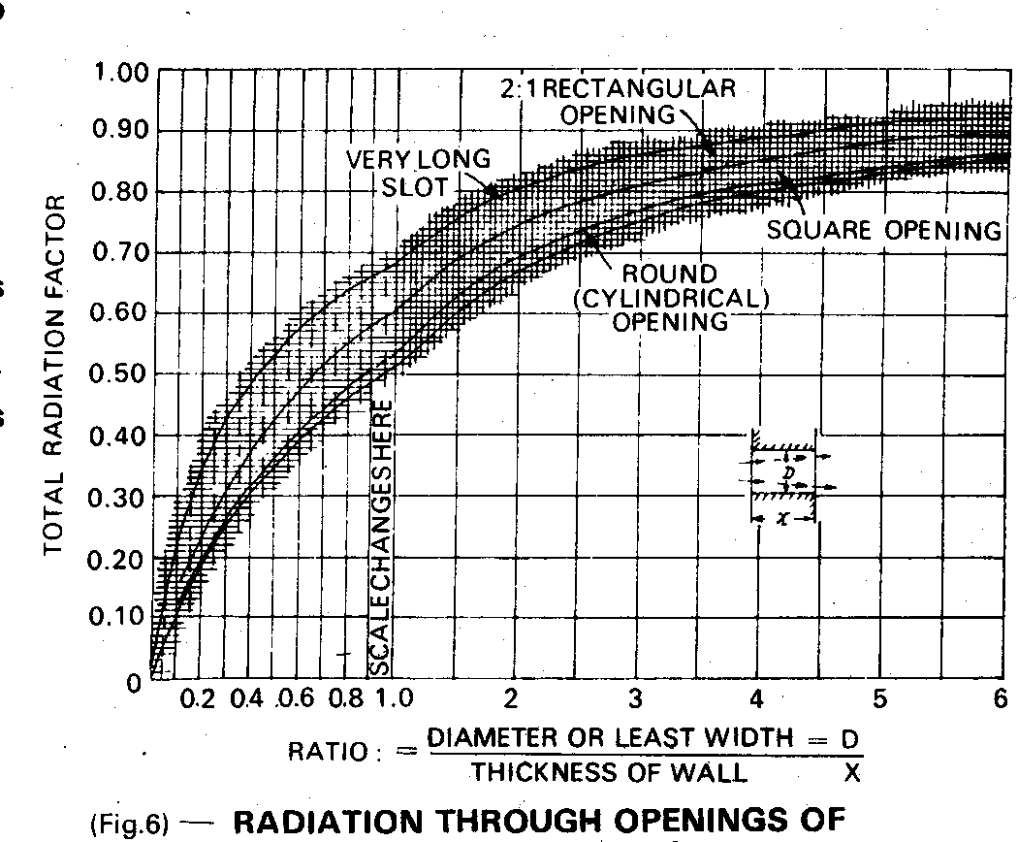
Figure 2.4 Factor for Determining the Equivalent of Heat Release from
Openings to the Quality of Heat Release from Perfect Black Body

Slide 20
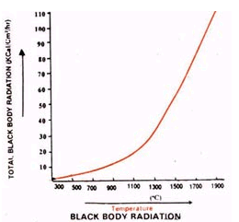
Figure 2.5 Graph for Determining Black Body Radiation
at a Particular Temperature

Slide 21
5. Heat Loss through Skin:
5a). Heat loss through roof and sidewalls:
Total average surface temperature = 122ºC
Heat loss at 122 ºC = 1252 kCal / m² / hr
Total area of heating + soaking zone = 70.18 m²
Heat loss = 1252 kCal / m² / hr x 70.18 m²
= 87865 kCal/hr
Equivalent oil loss (a) = 8.78 kg / hr
5b). Total average surface temperature of
area other than heating and soaking zone= 85ºC
Heat loss at 85ºC = 740 kCal / m² / hr
Total area = 12.6 m²
Heat loss = 740 kCal / m² / hr x 12.6 m²
= 9324 kCal/hr
Equivalent oil loss (b) = 0.93 kg / hr
Total loss of fuel oil = a + b = 9.71 kg/hr
Total percentage loss = 9.71 / 368 = 2.64%

Slide 22
Quantity of Heat Release at Various Temperatures

Slide 23
Furnace Efficiency (Indirect Method)
1. Sensible heat loss in flue gas = 57.29%
2. Loss due to evaporation of moisture in fuel = 1.36 %
3. Loss due to evaporation of water
formed from H₂ in fuel = 9.13 %
4. Heat loss due to openings = 5.56 %
5. Heat loss through skin = 2.64%
Total losses = 75.98 %
Furnace Efficiency = 100 – 75.98
= 24.02 %
Specific Energy Consumption = 400 litre /hour (fuel consumption)
6Tonnes/hour (Wt of stock)
= 66.6 Litre of fuel /tonne of Material (stock)

Slide 24
General Fuel Economy Measures in Furnaces
1) Complete combustion with minimum excess air
2) Correct heat distribution
3) Operating at the desired temperature
4) Reducing heat losses from furnace openings
5) Maintaining correct amount of furnace draught
6) Optimum capacity utilization
7) Waste heat recovery from the flue gases
8) Minimum refractory losses
9) Use of Ceramic Coatings

Slide 25
1) Complete Combustion with Minimum Excess Air
The amount of heat lost in the flue gases depends upon amount of excess air. In the case of a furnace carrying away flue gases at 900ºC, % heat lost is shown in table :
Table Heat Loss in Flue Gas Based on Excess Air Level
Excess Air
% of total heat in the fuel carried away by waste gases (flue gas temp. 900ºC)
25
48
50
55
75
63
100
71

Slide 26
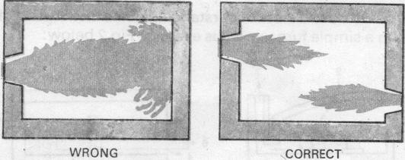
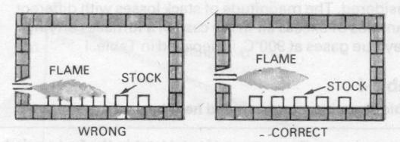
2) Correct Heat Distribution
Prevent flame impingement.
To avoid high flame temperature, damage of refractory and for better atomization
Heat distribution in furnace
Align burner properly to avoid touching the material
to reduce scale loss
Alignment of burners in furnace
Notes:
For proper heat distribution, when using oil burners, following care should be taken:
i) Prevent flame impingement.
Align burner properly to avoid touching the material
The flame should not touch any solid object and should propagate clear of any solid object .Any obstruction will deatomise the fuel particles thus affecting combustion and create black smoke. If flame impinges on the stock, there would be increase in scale losses.
ii) If the flames impinge on refractories, the incomplete combustion products can settle and react with the refractory constituents at high flame temperatures.
iii) The flames of different burners in the furnace should stay clear of each other. If they intersect, inefficient combustion would occur. It is desirable to stagger the burners on the opposite sides.
iv) The burner flame has a tendency to travel freely in the combustion space just above the material. In small reheating furnaces, the axis of the burner is never placed parallel to the hearth but always at an upward angle. Flame should not hit the roof.
v) The larger burners produce a long flame, which may be difficult to contain within the furnace walls. More burners of less capacity give better distribution of heat in the furnace and also increase furnace life.
vi) For small reheating furnaces, it is desirable to have a long flame with golden yellow colour while firing furnace oil for uniform heating. The flame should not be too long that it enters the chimney and comes out through the top or through doors. This will happen if excess oil is fired. In such cases, major portion of additional fuel is carried away from the furnace.

Slide 27
3) Operating at Desired Temperature
Temperature for Different Furnaces
CORRECT TEMPERATURE ENSURES GOOD QUALITY PRODUCTS.
TEMPERATURE HIGHER THAN REQUIRED WOULD ONLY USE UP MORE FUEL
Slab Reheating furnaces 1200ºC
Rolling Mill furnaces 1200ºC
Bar furnace for Sheet Mill 800ºC
Bogey type annealing furnaces- 650ºC -750ºC
For maintaining temperature, do not leave it to operator judgment, Use ON/OFF controls
Notes:
Operating at too high temperatures causes heat loss, excessive oxidation, de-carbonization as well as over-stressing of the refractories. These controls are normally left to operator judgment, which is not desirable. To avoid human error, on/off controls should be provided.

Slide 28
4) Reducing Heat Loss from Furnace Openings
Heat loss through openings consists of direct radiation and combustion gas that leaks through openings.
Keeping the doors unnecessarily open leads to wastage of fuel
Inspection doors should not kept open during operation
Broken and damaged doors should be repaired
The heat loss from an opening can be calculated using the formula:
Q=4.88 x T ⁴ x a x A x H … k.Cal/hr
100
T: absolute temperature (K),
a: factor for total radiation
A: area of opening,
H: time (Hr)
Notes:
Since the loss through open door is by radiation at a high temperature the heat losses are significant.

Slide 29
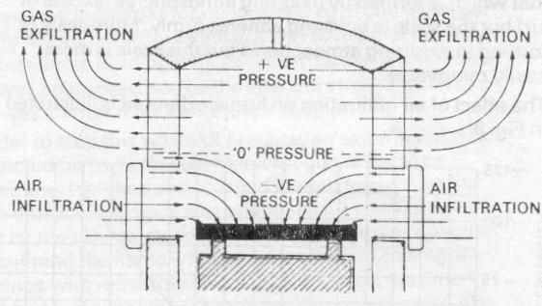
5) Maintaining correct amount of furnace draught
Negative pressures : air infiltration- affecting air-fuel ratio control, problems of cold metal and non-uniform metal temperatures,
Positive Pressure: Ex-filtration -Problems of leaping out of flames, overheating of refractories, burning out of ducts etc.
Notes:
Prevent air infiltration through furnace. Infiltrated air cools down the furnace and increases fuel consumption
If negative pressures exist in the furnace, air infiltration is liable to occur through the cracks and openings thereby affecting air-fuel ratio control. Tests conducted on apparently airtight furnaces have shown air infiltration up to the extent of 40%. Neglecting furnaces pressure could mean problems of cold metal and non-uniform metal temperatures, which could affect subsequent operations like forging and rolling and result in increased fuel consumption. For optimum fuel consumption, slight positive pressure should be maintained in the furnace

Slide 30
6) Optimum capacity utilization
There is a particular loading at which the furnace will operate at maximum thermal efficiency.
Best method of loading is generally obtained by trial-noting the weight of material put in at each charge, the time it takes to reach temperature and the amount of fuel used.
Mismatching of furnace dimension with respect to charge and production schedule.
Coordination between the furnace operator, production and planning personnel is needed.

Slide 31
7) Waste heat recovery from the flue gases
Stock preheating
Combustion air preheating
Using waste heat for other process

Slide 32
8. Minimizing Wall Losses
About 30% of the fuel input to the furnace generally goes to make up for heat losses in intermittent or continuous furnaces. The appropriate choice of refractory and insulation materials is needed for high fuel savings in industrial furnaces.
The extent of wall losses depend on:
Emissivity of wall
Thermal conductivity of refractories
Wall thickness
Whether furnace is operated continuously or intermittently
Notes:
The heat losses from-furnace walls affect the fuel economy considerably. The extent of wall losses depend on:
1. Emissivity of wall
2. Thermal conductivity of refractories
3. Wall thickness
4. Whether furnace is operated continuously or intermittently

Slide 33
Radiation Heat Loss from Surface of Furnace
The quantity (Q) of heat release from a reheating furnace is calculated with the following formula:
where
a : factor regarding direction of the surface of natural convection ceiling = 2.8,
side walls = 2.2, hearth = 1.5
t_{l} : temperature of external wall surface of the furnace (°C)
t₂ : temperature of air around the furnace (°C)
E: emissivity of external wall surface of the furnace

Slide 34
9.Use of Ceramic Coatings
The benefits of applying a high-emissivity ceramic coating:-
Rapid heat-up
Increased heat transfer at steady state
Improved temperature uniformity
Increased refractory life
Elimination of refractory dust.
Notes:
Heat transfer in furnace depends mainly on radiation which in turn depends on emissivity. At higher temperatures the emissivity decreases and is in the order of 0.3. High emissivity refractory coating if applied on the internal surface of the furnace increases the emissivity to 0.8, thus contributing to increased heat transfer.
The application of high-emissivity coatings in furnace chambers promotes rapid and efficient transfer of heat, uniform heating, and extended life of refractories and metallic components such as radiant tubes and heating elements. For intermittent furnaces or where rapid heating is required, use of such coatings was found to reduce fuel or power to tune of upto 10%. Other benefits are temperature uniformity and increased refractory life Case Study on Applications of Ceramic coatings to reduce energy consumption in furnaces
Process temperature- 1000oC
Ceramic coating has the property of radiating heat inside the furnace
BENEFITS
Reduced start-up time
Uniform temperature distribution inside the furnace
Savings- $1000
Investment- $2000
Payback- 24 months

Slide 35
Furnace Instrumentation
Sl. No. | Parameters to be measured | Location of Measurement | Instrument Required | Required Value
1. | Furnace soaking zone temperature (reheating furnaces) | Soaking zone side wall | Pt/Pt-Rh thermocouple with indicator and recorder | 1200-1300ºC
2. | Flue gas | Flue gas exit from furnace and entry to re-cuperator | Chromel Alummel Thermocouple with indicator | 700ºC max.
3. | Flue gas | After recuperator | Hg in steel thermometer | 300ºC (max)
4. | Furnace hearth pressure in the heating zone | Near charging end side wall over hearth level | Low pressure ring gauge | +0.1 mm. of Wg
5. | Flue gas analyser | Near charging end side wall end side | Fuel efficiency monitor for oxygen & temperature. | O₂% = 5 t = 700ºC (max)
6. | Billet temperature | Portable | Infrared Pyrometer or optical pyrometer | ----

Slide 36
Thank you

