Slide 1
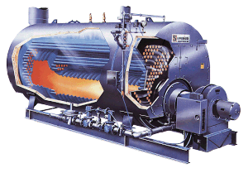
Energy Efficiency in Boiler System

Slide 2
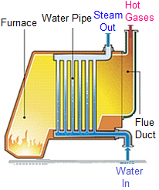
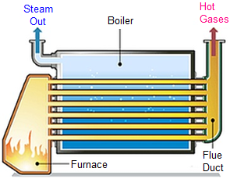
Boilers
Pressure vessel for producing steam or hot water
Steam boilers are able to burn fossil fuels like oil, gas, and coal
A major portion of energy (fuel) in a facility is accounted for by boiler plant
Classified broadly as Fire tube boilers or Water tube boilers
Water Tube
Fire Tube
Notes:
22 litres

Slide 3
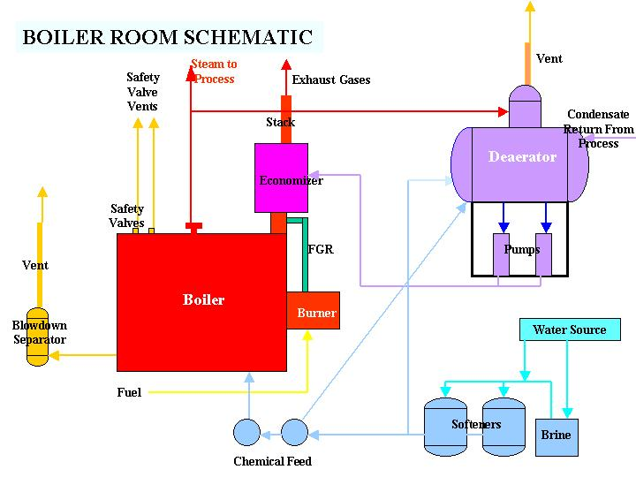
Boiler System
Water treatment system
Feed water system
Steam System
Blow down system
Fuel supply system
Air Supply system
Flue gas system

Slide 4
Boiler Efficiency
Major losses in boiler
BOILER
Heat loss due to dry flue gas
Heat loss due to steam in fuel gas
Fuel
Heat loss due to moisture in fuel
Heat loss due to moisture in air
Heat loss due to unburnts in residue
Heat loss due to radiation & other unaccounted loss
Heat in Steam

Slide 5
Boiler Efficiency
Boiler efficiency is measure of how effectively heat is transferred from combustion gases to water or steam
Two methods for assessing boiler efficiency:
  Direct method
  Indirect method
Stack Gas
FUEL INPUT
STEAM OUTPUT
Convection & Radiation
Blow Down
Ash and Un-burnt parts of Fuel in Ash

Slide 6
Efficiency Using Direct Method
Boiler efficiency = Heat absorbed in steam
Heat supplied by fuel
Heat supplied by the fuel depends on the product of quantity of the fuel burnt (kg/hr) and its calorific value (kcal/kg or kJ/kg)
= Flow rate of steam x (Enthalpy of steam – Enthalpy of feed water) x 100
Quantity of fuel fired x Calorific value of fuel
Evaporation Ratio (Steam-Fuel consumption ratio)
= Feed water consumption (kg/hr)
Fuel consumption (kg/hr)

Slide 7
Efficiency Calculation by Direct Method
Type of boiler: Coal fired Boiler
Heat input data
Qty of coal consumed :1.8 TPH
GCV of coal :3200K.Cal/kg
Heat output data
Qty of steam gen : 8 TPH
Steam pr/temp:10 kg/cm²(g)/180⁰C
Enthalpy of steam(sat) at 10 kg/cm²(g) pressure:665 KCal/kg
Feed water temperature : 85⁰ C
Enthalpy of feed water : 85 KCal/kg
Find out the Find efficiency ?
Find out the Evaporation Ratio?

Slide 8
Boiler efficiency (η): = Q x (H – h) x 100
(q x GCV)
Where Q = Quantity of steam generated per hour (kg/hr)
H = Enthalpy of saturated steam (kcal/kg)
h = Enthalpy of feed water (kcal/kg)
q = Quantity of fuel used per hour (kg/hr)
GCV = Gross calorific value of the fuel (kcal/kg)
Boiler efficiency (η)= 8 TPH x1000Kg/Tx (665–85) x 100
1.8 TPH x 1000Kg/T x 3200
= 80.0%
Evaporation Ratio = 8 Tonne of steam/1.8 Ton of coal
= 4.4

Slide 9
Typical Evaporation Ratios
Type of fuel | Typical Evaporation Ratio
Fuel oil Solid fuel Gaseous fuel | ~ 13–14 kg steam/kg fuel oil ~ 4–5 kg steam/kg solid fuel ~ 13 kg steam/Nm³ gaseous fuel

Slide 10
Efficiency Using Indirect Method
Reference Standard for Boiler Testing at Site
British Standard, BS 845:1987
USA Standard ASME PTC-4-1 Power Test Code Steam Generating Units
Indirect method is also called the heat loss method
Efficiency is calculated by subtracting the heat loss fractions from 100

Slide 11
Efficiency Using Indirect Method
Efficiency of boiler (η) = 100 - (i + ii + iii + iv + v + vi + vii)
The various losses occurring in a boiler are as follows:
Dry flue gas
Evaporation of water formed due to hydrogen (H₂) in fuel
Evaporation of moisture in fuel
Moisture present in combustion air
Unburnt fuel in fly ash
Unburnt fuel in bottom ash
Radiation and other unaccounted losses

Slide 12
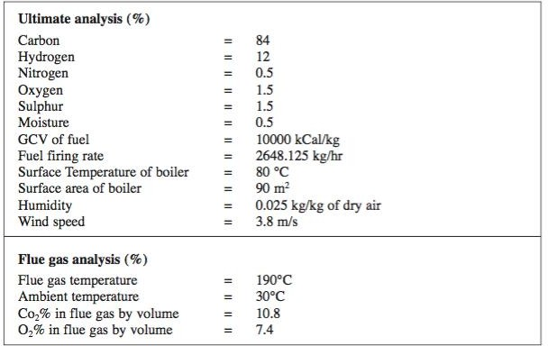
Efficiency Using Indirect Method

Slide 13
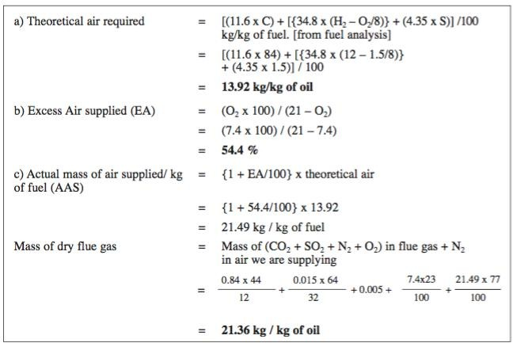
Efficiency Using Indirect Method

Slide 14
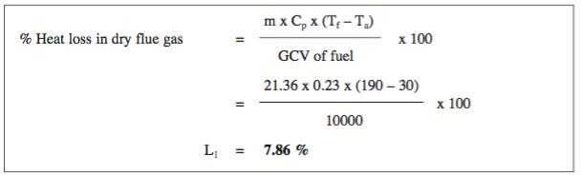
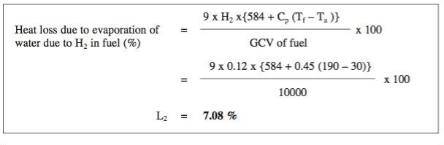
Efficiency Using Indirect Method

Slide 15
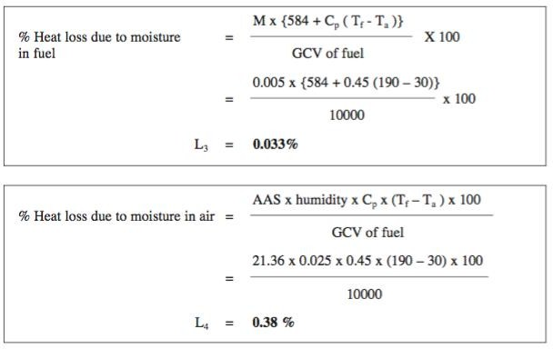
Efficiency Using Indirect Method

Slide 16
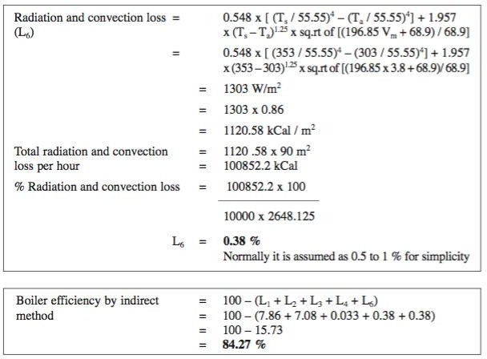
Efficiency Using Indirect Method

Slide 17
Summary of Heat Balance for the Boiler Using Furnace Oil
Input / Output Parameter |  | kCal / kg of furnace oil | % Loss
Heat Input | = | 10000 | 100
Losses in boiler :
1. Dry flue gas, L1 | = | 786 | 7.86
2. Loss due to hydrogen in fuel, L2 | = | 708 | 7.08
3. Loss due to Moisture in fuel, L3 | = | 3.3 | 0.033
4. Loss due to Moisture in air, L4 | = | 38 | 0.38
5. Partial combustion of C to CO, L5 | = | 0 | 0
6. Surface heat losses, L6 | = | 38 | 0.38
Boiler Efficiency = 100 - (L1 + L2 + L3 + L4 + L6) = 84.27 %

Slide 18
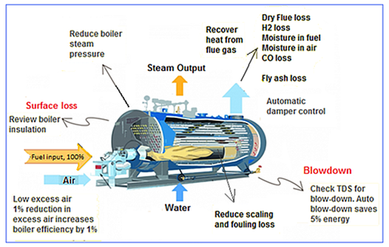
Boiler System Energy Savings

Slide 19
Flue Gas Loss
Boiler System Energy Savings
High excess air high flue gas loss
Insufficient air-incomplete combustion and soot built-up
Excess air norm- 10-15% (2-3% O₂)
Type of Fuel | Oxygen (%) | Carbon dioxide (%) | Carbon monoxide (ppm) | Excess air (%)
Liquid fuel | 3–4 | 12–14 | <200 | 10–20
Gas fuel | 1–2 | 9–10 | <200 | 10–20
Solid fuel | 12–13 | 12–13 | <200 | 50–70
Notes:
Amount of air required for combustion depends on the type of fuel used
Excess air is needed to ensure complete combustion of fuel
Excess air to kept at optimum level

Slide 20
Reduce Stack Temperature
Stack temperatures greater than 200°C indicates potential for recovery of waste heat.
It also indicate the scaling of heat transfer/recovery equipment and hence the urgency of taking an early shut down for water / flue side cleaning.
22º C reduction in flue gas temperature increases boiler efficiency by 1%

Slide 21
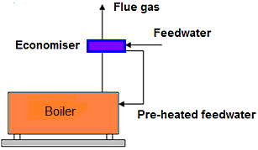
Waste Heat Recovery from Flue Gas
Boiler System Energy Savings
Temperatures of flue gas: 180 -250ºC
About 10–20% Flue gas heat loss
Waste heat recovery heat exchanger (Economizer or Recuperator)
Potential flue gas temperature margin should be at least 25–30ºC

Slide 22
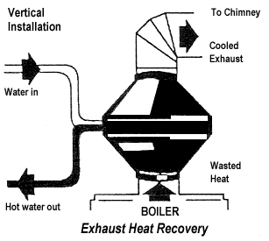
Feed Water Preheating using Economizer
For an older shell boiler, with a flue gas exit temperature of 260ºC, an economizer could be used to reduce it to 200ºC, Increase in overall thermal efficiency would be in the order of 3%.
Condensing economizer(N.Gas) Flue gas reduction up to 65ºC
6ºC raise in feed water temperature, by economiser/condensate recovery, corresponds to a 1% saving in fuel consumption

Slide 23
Combustion Air Preheating
Combustion air preheating is an alternative to feedwater heating.
In order to improve thermal efficiency by 1%, the combustion air temperature must be raised by 20 ºC.

Slide 24
Incomplete Combustion
Incomplete combustion can arise from a shortage of air or surplus of fuel or poor distribution of fuel.
In the case of oil and gas fired systems, CO or smoke with normal or high excess air indicates burner system problems.
Example: Poor mixing of fuel and air at the burner. Poor oil fires can result from improper viscosity, worn tips, carbonization on tips and deterioration of diffusers.
With coal firing: Loss occurs as grit carry-over or carbon-in-ash (2% loss).
Notes:
Incomplete Combustion
(c c c c c + co co co co)

Slide 25
Control excess air
for every 1% reduction in excess air ,0.6% rise in efficiency
Notes:
The optimum excess air level varies with furnace design, type of burner, fuel and process variables.. Install oxygen trim system

Slide 26
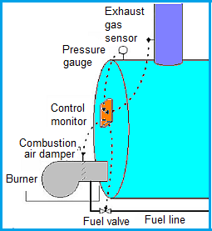
Oxygen Trim System
Boiler System Energy Savings
Monitors Oxygen level in flue gas and automatically adjusts the air-to-fuel ratio for maximum combustion efficiency
Oxygen level and excess air in flue gas kept optimum at all loads
Reduces energy consumption by 1.5–2.0%
Payback period less than 3 years

Slide 27
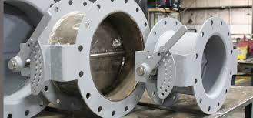
Automatic Damper Control
Boiler System Energy Savings
High draft – High excess air
Damper between boiler and stack automatically controls the draft by opening or closing the damper depending on the feedback from O₂ (excess air) level

Slide 28
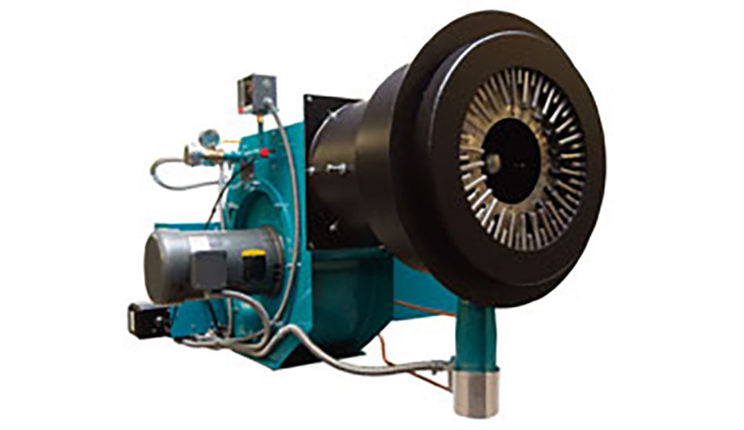
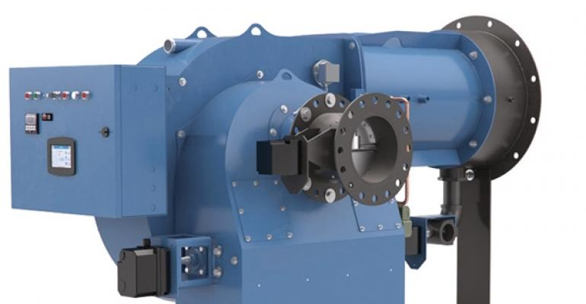
Low Excess Air Burner
Boiler System Energy Savings
Older burners require more excess air for combustion
Low excess air burners not only operate with low excess air but improve combustion efficiency as well

Slide 29
Blowdown
Boiler System Energy Savings
Blowdown is a discharge of water at steam temperature to remove sludge and solids from boiler
Conductivity, silica, chlorides concentrations, alkalinity indicate presence of dissolved salts and other contaminants in boiler water
Blowdown water has to be replaced by an equivalent amount of feed water
Boiler blowdown (%) = Feed water TDS x % Makeup water
Maximum Permissible TDS in Boiler water
Blowdown rate is set proportional to makeup water flow or automated (probe provides feedback to a controller operating a modulating blowdown valve)

Slide 30
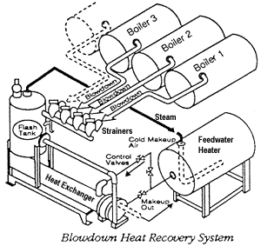
Blowdown Heat Recovery
Efficiency Improvement - Up to 2 percentage points.
The amount of blowdown should be minimized by following a good water treatment program, but installing a heat exchanger in the blowdown line allows this waste heat to be used in preheating makeup and feedwater.
Heat recovery is most suitable for continuous blowdown operations which in turn provides the best water treatment program.

Slide 31
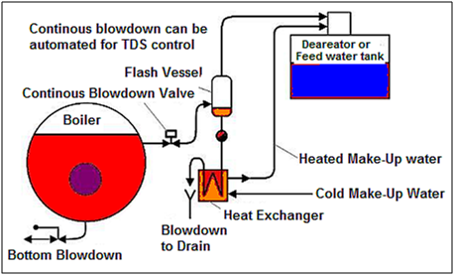
Automatic Blowdown Control and Heat Recovery System
Boiler System Energy Savings
Heat recovery system recommended for continuous blowdown with atleast 5% makeup water
Fresh makeup water is heated
Flash steam can also be recovered as low-pressure steam or condensed back for reuse as boiler feed water

Slide 32
Boiler System Energy Savings
Fouling or scaling- Water side
Act as insulators and reduces heat transfer resulting in higher flue gas temperature
Higher flue gas temperatures at constant steam demand and excess air level
Water treatment has to be improved- Improve water softening and maintaining lower total dissolved solids (TDS) through injecting chemicals into boiler feed water and adopting proper boiler blowdown
Soot- Fire side
Act as insulators and reduce heat transfer resulting in higher flue gas temperature
Burner is defective or air supply is insufficient.
Surfaces should be cleaned of soot periodically
Repair the burner and fine-tune the combustion system.

Slide 33
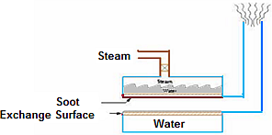
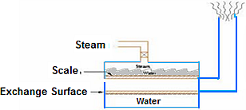
Fouling and Scaling
Scale formation
Soot formation

Slide 34
Reduction of Boiler Steam Pressure
Lower steam pressure gives a lower saturated steam temperature and without stack heat recovery, a similar reduction in the temperature of the flue gas temperature results. Potential 1 to 2% improvement.
Steam is generated at pressures normally dictated by the highest pressure / temperature requirements for a particular process. In some cases, the process does not operate all the time, and there are periods when the boiler pressure could be reduced.
Adverse effects, such as an increase in water carryover from the boiler owing to pressure reduction, may negate any potential saving.
Pressure should be reduced in stages, and no more than a 20 percent reduction should be considered.

Slide 35
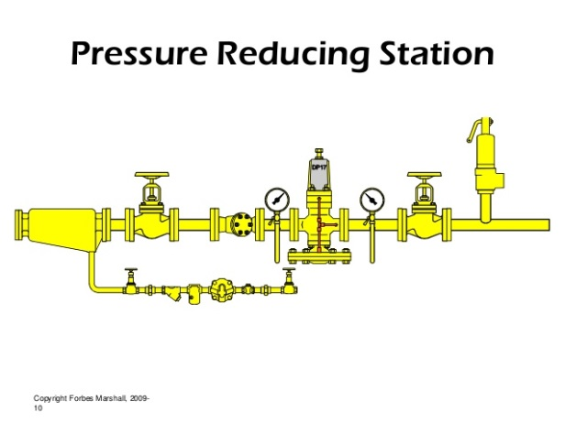
Steam Generation Pressure Reduction
Boiler System Energy Savings
High pressure steam-high fuel combustion
Boiler steam pressure should be based on the temperature required in the heating process
Not on steam pressure that can be generated in boiler
Reset steam pressure in boiler to match with the actual steam load requirements to save energy
Recommended steam pressure = Maximum pressure required + Pressure drop in the system

Slide 36
Benefits of Low-pressure Steam
Boiler System Energy Savings
Latent heat for condensing steam is higher at lower pressure
Steam dryness ratio will increase resulting in increase in energy in steam
Steam loss from pipes will be lower at lower steam pressure
Heat loss at boiler surface and steam distribution system will be less at lower steam pressure
Blowdown loss will be less at lower steam pressure
Fuel consumption will be lower for the same amount of steam generation

Slide 37
Variable Speed Control for Fans, Blowers and Pumps
Generally, combustion air control is effected by throttling dampers fitted at forced and induced draft fans.
Though dampers are simple means of control, they lack accuracy, giving poor control characteristics at the top and bottom of the operating range.
If the load characteristic of the boiler is variable, the possibility of replacing the dampers by a VSD should be evaluated.

Slide 38
Retrofitting Boiler with VFD
Boiler System Energy Savings
Boiler Fan at Constant Speed
Best for boiler operating at constant steam load
For part load --damper control air flow to match with steam load
Damper create resistance in air flow-Fan power increases
Boiler Fan at VFD
Best for boiler operating at varying steam load or low load for longer time
Fan power ∝ (air flow rate)³

Slide 39
Effect of Boiler Loading on Efficiency
As the load falls, so does the value of the mass flow rate of the flue gases through the tubes. This reduction in flow rate for the same heat transfer area, reduced the exit flue gas temperatures by a small extent, reducing the sensible heat loss.
Below half load, most combustion appliances need more excess air to burn the fuel completely and increases the sensible heat loss.
Operation of boiler below 25% should be avoided
Optimum efficiency occurs at 65-85% of full loads

Slide 40
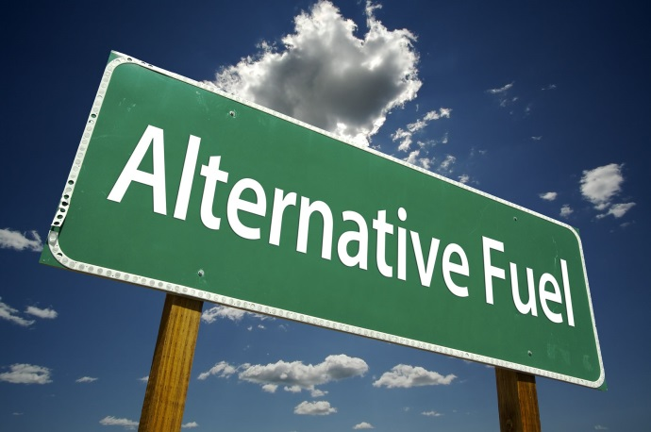
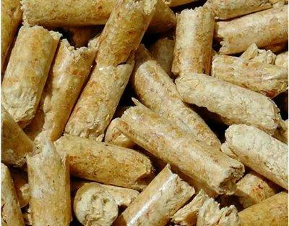
Switching Fuels
Boiler System Energy Savings
Switch fuel based on price
Saves on energy cost- not energy consumption
Oil to Biomass

Slide 41
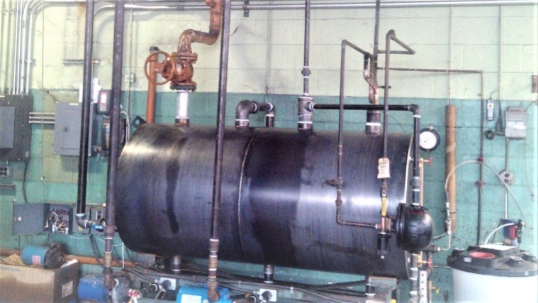
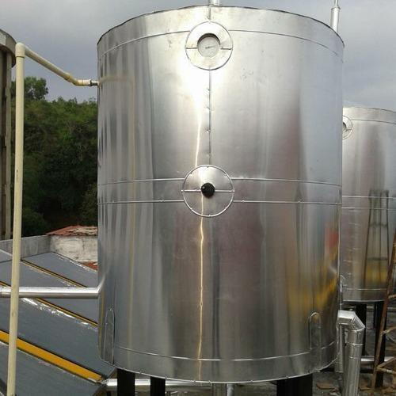
Feed Water Tank Insulation
Boiler System Energy Savings
Feed water tank is a reservoir of condensate and fresh makeup water for boilers
Feed water is normally hot due to returned condensate and recovery of heat from other sources
Uninsulated feed water tank and uncovered (at top) losses heat from sides as well as top in form of evaporation

Slide 42
Boiler Replacement
if the existing boiler is :
Old and inefficient, not capable of firing cheaper substitution fuel, over or under-sized for present requirements, not designed for ideal loading conditions replacement option should be explored.
Since boiler plants traditionally have a useful life of well over 25 years, replacement must be carefully studied.

Slide 43
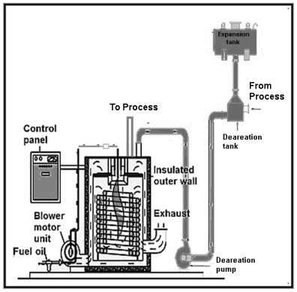
Thermic Fluid Heater

Slide 44
Energy Auditing Approach
Data and Information
Collect boiler details: type, rated steam pressure, temperature, and steam capacity.
Collect feed water pump details: type, no. of stages, flow, and pressure.
Record allowable TDS in boiler.
Collect FD/ID fan flow, pressure, motor rating, kW.
Collect burner details: type, rated temperature, pressure, turndown ratio.
Collect supply and return thermic fluid temperature.
Assess thermic fluid loads (temperature, flow).

Slide 45
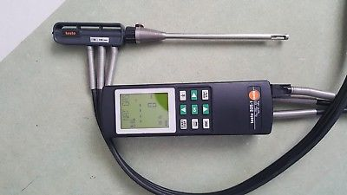
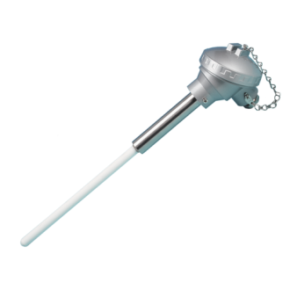
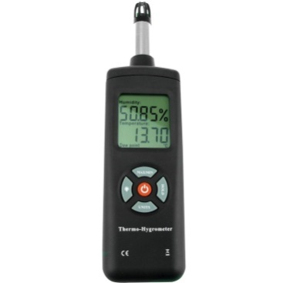
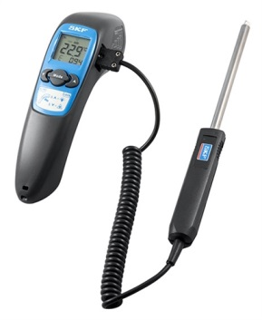
Energy Auditing Approach
Instruments and Measurements
Flue gas analyzer
Thermocouple
Contact thermometer
Hygrometer

Slide 46

Energy Auditing Approach
Field Audit
Examine the boiler/thermic fluid log book.
Review operating steam/thermic fluid pressure.
Review operating steam temperature and thermic fluid temperatures.
Review steam production records.
Measure steam/thermic fluid flows through meters. Steam flow can be indirectly through feed water meter or from level measurements in overhead tank.
Review fuel consumption records and check fuel (oil) consumption by measuring difference in fuel oil tank level.
Measure gas measurement through gas meter.
Review make-up water records.

Slide 47
Energy Auditing Approach
Field Audit
Check condensate return, quantity, and temperature.
Measure feed water temperature.
Measure O₂, CO₂ percent in exhaust flue gas, CO level in ppm.
Measure oil pre-heat temperature and pressure.
Review Allowable TDS in boiler and TDS in blowdown.
Measure O₂ level before and after heat recovery equipment like economizer, air pre-heater.
Check insulation of feed water tank (measure surface temperature and calculate heat losses).
Prepare schematic of water treatment system.
Review feed water and make-up water testing procedures.

Slide 48

Energy Auditing Approach
Analysis
Assess steam-fuel ratio (Evaporation Ratio).
Assess efficiency by direct method/indirect method.
Compare excess air levels against desirable levels.
Check whether oil pre-heating is adequate.
Check condition of fuel firing equipment (burner, coal grate).
Review flue gas temperature trend over last few months.
Conduct mass and energy balance of boiler system including blowdown.
Evaluate scope for waste heat recovery.

Slide 49
ENCON Opportunities
Thermic Fluid Heaters
Operational and Housekeeping Measures
Optimize excess air.
  Higher excess air increases flue gas quantity and stack loss. It also reduces flame temperature, radiation heat transfer, and heat transfer to heating surfaces. Lower excess air may result in incomplete combustion which leads to formation of CO in flue gas. The maximum permissible CO level is 1%.
Reduce thermic fluid outlet temperature
  If temperature difference between thermic fluid outlet temperature and the medium being heated is quite high, it may be possible to reduce the outlet temperature after conducting field trials. This will also reduce stack loss as well as radiation loss from the thermic fluid heater circuit.

Slide 50
ENCON Opportunities
Thermic Fluid Heaters
Low Cost Measures
Optimize burner nozzle size. If the thermic fluid heater operates at low fire for long period in a cycle rather than high fire, the efficiency of heater will be lower. In such cases, it is better to improve overall energy efficiency by changing the nozzle size so that heater output matches with the system load.
Optimize the flow of thermal oil for multiple process heating applications: when a single thermic fluid heater is used to provide heat to many processes or systems, it is important to supply correct quantity of thermal oil to each process by controlling the mass flow rate of thermic fluid using auto-control valves.
Upgrading the condition of insulation of thermic fluid heater and distribution pipelines.
Check for and remove redundant lines and valves in distribution lines to reduce distribution losses.

Slide 51
ENCON Opportunities
Thermic Fluid Heaters
Retrofit Measures
Replacement of inefficient and old thermic fluid heaters: Older models have efficiencies of lower than 50% under low and high fire as against over 80% under low and high fire for recent models.
Switch over to new fuel preferably renewable type like biomass.

Slide 52
CASE STUDIES

Slide 53
Damper control
Agro Based Industry
Boiler
6 TPH
10.75 Kg/cm2
Coconut shell
fired
Economiser
Dust
Collector
Primary Air
Fan
Secondary Air
Fan
14 %
Damper
9 %
Hopper
Induced Draft
Fan
Coconut shell
crusher
Notes:
Initially damper is kept 100% open and excess air level is 200% corresponding to O₂ % of 14%. Corresponding flue gas loss is 16.7%.
For improved condition, damper is set at 50% open, O2 level of 9% and excess air is reduced to 75%. Corresponding flue gas loss is 9.6%. Efficiency improvement is 6.7%.
Existing condition
% ID fan opening - 100%
% O2 in flue gas - 14%
Excess air - O₂/(21 - O₂)
-14/(21 – 14)
-200%
Dry flue gas loss - (10.37 x 3*1 x .23 (125 - 30) - 16.7%
4200
Improved Condition
% ID fan damper opening - 50 %
% O2 in flue gas - 9 %
% Excess air - 9/(21 – 9)
- 75%
Dry flue gas loss [(10.37 x 1.75) +1] x .23 x (95) - 9.96%
4200
% Efficiency Improvement - 6.7%

Slide 54
Fuel Savings
By damper control O₂ in flue gas brought down from 14 to 9 %
Correspondingly excess air from 200 to 75 %
Savings in coconut shell consumption – 5 %
Notes:
Summary of fuel savings due to boiler efficiency improvement is summarised in the slide.
Fuel firing rate - 17 ton/day
Minimum FUEL saving by excess air control - 5%
- 850 kg/day
Annual fuel savings - 850 x 300 days
- 25.5 ton/year
Suggestion:
To sustain the savings
Procure fyrite and analyse flue gas periodically twice in a shift maintain
CO₂ within 9%

Slide 55
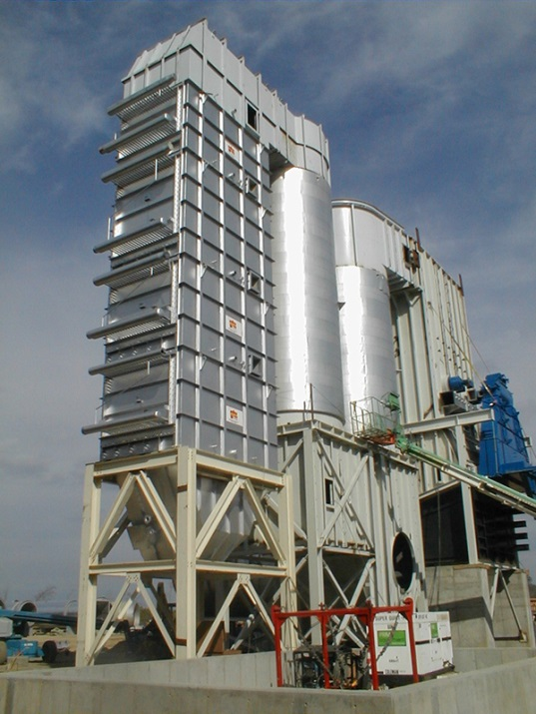
Fertilizer Plant
Waste Heat Recovery
Existing System
Number of Boilers – 3
Type of boilers – Pulverized coal fired
Average flue gas temperature 200⁰C
Efficiency of Boiler – 78 %
Annual coal consumption – 436759 T
Proposed System
Installation of Air Pre Heater
Reduce Flue Gas Temperature - 170⁰C
Improvement in boiler efficiency – 1.78 %
Annual Fuel savings – 9608 T
Annual Monetary savings – Rs 1.5 Crores
Investment : Rs 3 Crores
Pay back period : 2 years

