Slide 1
Managing a Modern Dairy and Quality Standards
By
Dr P.Raja
BE.,MBA., Msc(TQM)., Mphil., PhD., PGDESD., PGD(T&D).,
PGDHRM., PGDMM

Slide 2
Modern
Relating the recent past/remote past to the present time
Design and made using most recent ideas and methods (Cambridge )

Slide 3
Managing
Organising
Management
Scientific Management
Management by objectives
Total Quality Management (TQM) - J
LPP -E
SIX SIGMA -A
All others says ?

Slide 4
Good only be managed
Trained efficient People
Well maintained efficient machines
Very good raw Material
Electronic control system/ Computerized control
Efficient environment
Required Financial support
Norms for every activity

Slide 5
Expectation in Modern Dairy
Optimum level infrastructure / Convenient
Semi/ full Automation
Top Priority for hygiene and sanitation
Energy conservation
Systematic electronic controls
Good MIS system
Continuous up keeping
IT application
Good HRD practice ??????????

Slide 6
Standards &Standardization
Standard
1. A level of Quality or attainment
Quality , level, grade, degree, worth,
caliber, merit, excellent.
Their restaurant offer high standard of service
2. Some thing used as a measure, norm or model in comparative evaluation
The oil price is low as of today's standard
Standardization Process of creating, implementing ,monitoring and controlling of standards

Slide 7
First step to improving a processes is to eliminate the waste with the following techniques
Value added assessment
Eliminating non value adding activities
Minimize checks and inspections
Minimize administrative tasks
Minimize storage and transportation activities

Slide 8
Human – A big problem
Aware & Understand - HR
Develop HR - HRD
Manage MR - HRM

Slide 9
ISO Standards/
Modern And complex organization needs to be managed by implementing Process Approach
QMS - IS/ISO 9001: 2015
EMS - IS / ISO 14001: 2015
EnMS - IS/ ISO 50001
FSMS - IS/ ISO 22000
OHSAS -IS/ BS 18001 Going to be ISO: 45001

Slide 10
QUALITY POLICY
TCMPF is committed to continually improve the process of meeting and exceeding the customer expectations, by providing hygiene, safe environment and competent work force through out the organization.

Slide 11
QUALITY OBJECTIVES
Involve all employees
Improve the processes
Meet and exceed the expectations of the customers
Achieve high standards in hygiene
Achieve high standards in food safety
Continual Improvement

Slide 12
H.A.C.C.P. FOOD SAFETY POLICY
TCMPF is committed to ensure supply of safer milk and milk products to its customers.
AT EVERY STAGE OF OPERATION (OBJECTIVES):
Focusing on Hazard free raw material
Pathogen free finished products
Adopting food manufacturing and hygiene practices &
Adopting good storage practices

Slide 13
Environmental Policy
Tamilnadu Co-operative Milk Producers Federation Limited is committed to process milk and produce milk products of quality with continual improvement in environmental performance.
We will focus on
Pollution prevention by reducing air emissions, waste water and solid . wastes
Compliance with relevant legislation and other requirements.
Optimizing resource usage such as water, energy and chemicals.

Slide 14
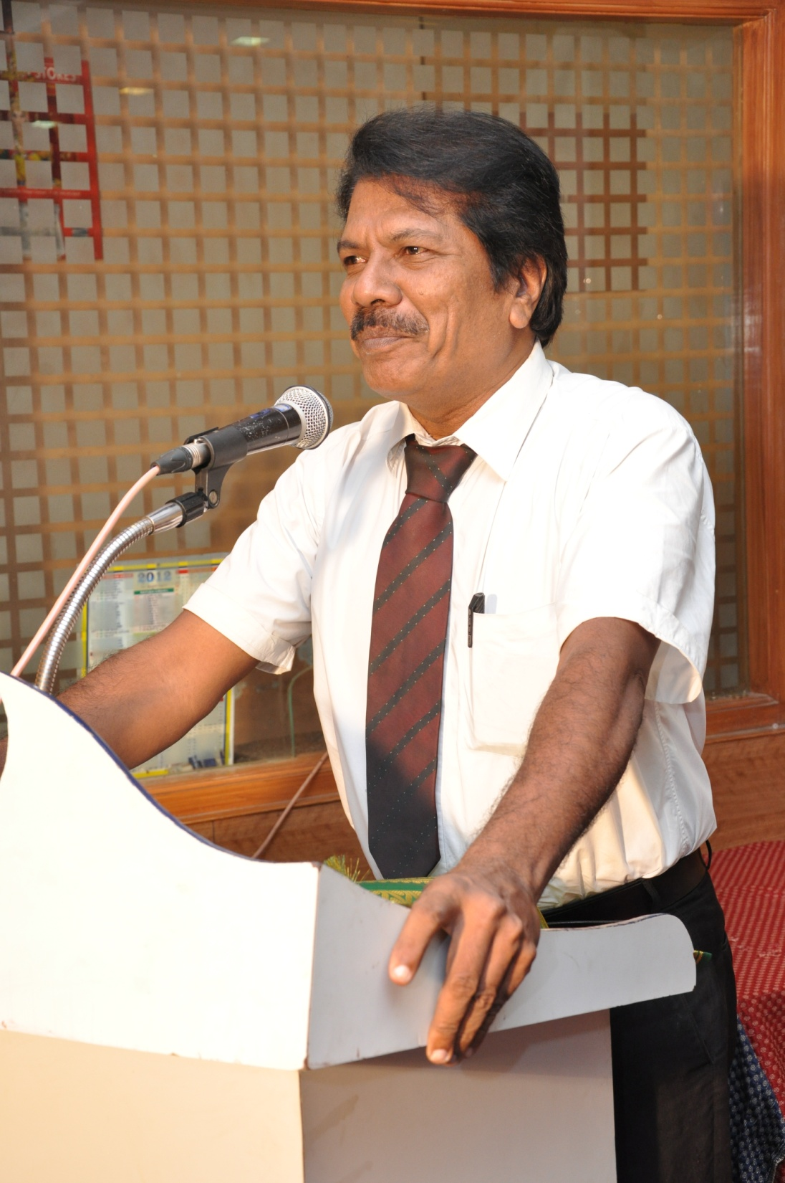

Slide 16
END & THANKS

