Slide 1
Skyshade™
Innovation in Daylighting & Shades
We Reduce Energy Consumption & Provide Healthy Ambience
Lightpipe™ Profile
This is a property of Skyshade. It Cannot be reproduced partly or wholly without permission

Slide 2
Vision
“To develop and manufacture products for effective use of Solar energy for Daylighting applications to reduce carbon foot print of Buildings”
This is a property of Skyshade. It Cannot be reproduced partly or wholly without permission

Slide 3
About us
Pioneer in providing Daylighting and Shading Solutions in India.
Has been in the Renewable Energy domain since 1995.
First company in India to indigenously build and commercialize Lightpipe™ - Solar Daylighting System.
First company in India to indigenously build and commercialize Lightpipe™ and Angle selective light glazing systems.
This is a property of Skyshade. It Cannot be reproduced partly or wholly without permission

Slide 4
Achievements
National award for Most Innovative Energy Saving Product-2011.
Finalist in the Sankalp Social Enterprise Awards-2010.
Finalist in New Ventures India Awards-2008.
First company in India to have in-house R&D facility for Daylighting Systems.
Active member of Indian Green Building Congress since 2008.
Industry partner for Indo-US Clean Energy research center project.
Published several articles on Daylighting applications in leading building and
construction magazines.
This is a property of Skyshade. It Cannot be reproduced partly or wholly without permission

Slide 5
Our Expertise
Solar Lightpipe™ - The Daylighting System that transports light.
Skyshelves™ - The Daylighting System for Windows & Glass.
Norikool ADS™ - Advanced Skylights Systems.
Fiber optic solar lighting – Sunlight delivered through optical fiber.
Tensioned Fabric Structures – Architecturally Engineered
Shading Solutions.
This is a property of Skyshade. It Cannot be reproduced partly or wholly without permission

Slide 6
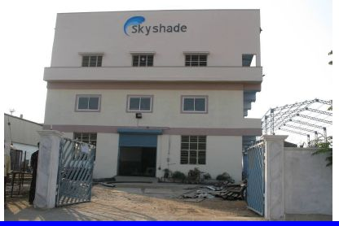
Infrastructure
Manufacturing Unit:
The company owns a fully equipped manufacturing unit for all products.
Design Facility:
Design of Daylighting Product Solution.
Design of Tensioned Fabric Structures.
Design of Steel Structures.
Our Team - Our Strength
The company has technically qualified
design engineers, draftsman's, experienced
fabricators and skilled Technicians for erection.
The design. fabrication and erection
departments are headed by senior managers.

Slide 7
Research & Development
R & D On Daylighting Solutions:
Daylighting Lab is the dedicated R & D center of Skyshade,
the first of it’s kind of in India.
The lab works in development and testing of Daylighting systems.
Daylighting Lab is equipped with research light grade sensors,
Light integrates, test rooms for prototypes & other facilities.
Realizing the importance of this, Skyshade is developing this
center into major development lab.

Slide 8
This is a property of Skyshade. It Cannot be reproduced partly or wholly without permission

Slide 9
This is a property of Skyshade. It Cannot be reproduced partly or wholly without permission

Slide 10
This is a property of Skyshade. It Cannot be reproduced partly or wholly without permission

Slide 11
Skyshade
Innovation in Daylighting to Reduce Energy Consumption
This is a property of Skyshade. It Cannot be reproduced partly or wholly without permission

Slide 12
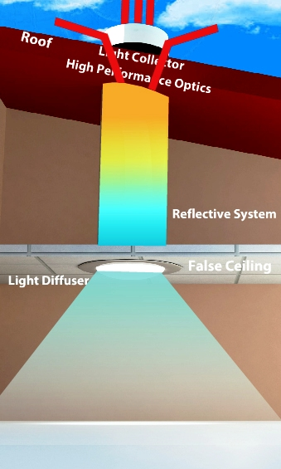
How it works?
Light Collector:
High impact strength, UV stable, light collector collects sunlight from all directions and delivers light effectively through out the day even at low sun angles.
Reflective System:
The specialty reflective system delivers high luminance without color shift even on cloudy days.
Light Diffuser:
The intensified sunlight in Lightpipe is controlled and distributed into indoor spaces by lighting diffusers.
This is a property of Skyshade. It Cannot be reproduced partly or wholly without permission

Slide 13
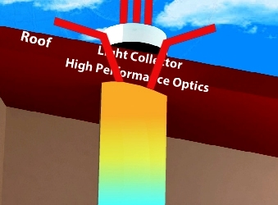
Light Collector:
Low angle sunlight (Morning & Evening) is boosted.
Lightpipe™ delivers more uniform Daylighting through out the day.
Mid noon Sun Radiation is partially rejected
Blocks UV Radiation.
This is a property of Skyshade. It Cannot be reproduced partly or wholly without permission

Slide 14
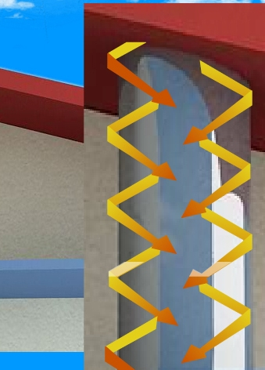
Reflective System:
High continuous Reflective system.
Delivers more Light.
Minimal loss of transmission by aging.
No change of light Color.
Durable & Long life.
This is a property of Skyshade. It Cannot be reproduced partly or wholly without permission

Slide 15
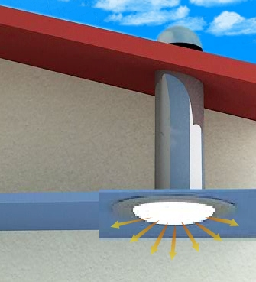
Light Diffuser:
Skyshade understands that light diffusers need to control light based on
Glare
Light Spread & Distribution.
Human comfort to Daylight in indoors.
This is a property of Skyshade. It Cannot be reproduced partly or wholly without permission

Slide 16
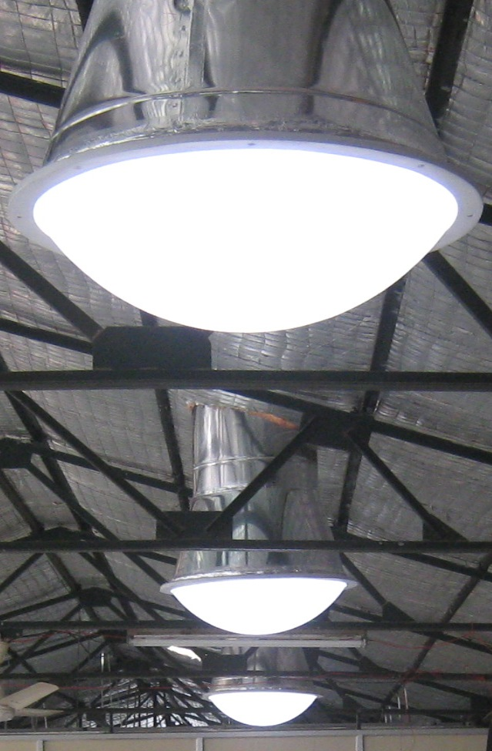
Light Diffuser:
Clear Bright:
High Light Transmission.
Medium Light Distribution.
Applicable for high roof Industrial buildings/Warehouses/Commercial buildings.
Dome shape wider distribution
This is a property of Skyshade. It Cannot be reproduced partly or wholly without permission

Slide 17
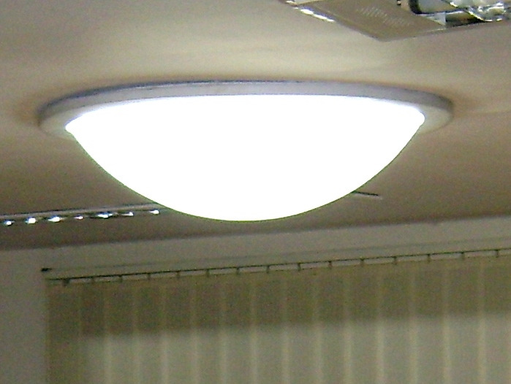
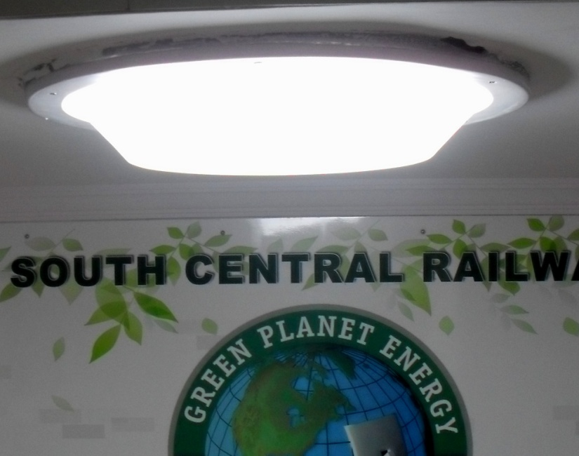
Light Diffuser:
Soft White
Soft, Pleasing Light.
High Lighting distribution.
Applicable for low roof.
Application-Offices & Residences
Dome & Flat Shaped diffuser options.
This is a property of Skyshade. It Cannot be reproduced partly or wholly without permission

Slide 18
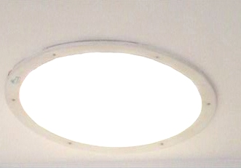
Light Diffuser:
Bright Vision
High light Transmission.
High light Diffusion.
Controlled light distribution.
Applicable for Commercial buildings/Warehouses/Industrial Buildings/Offices.
Flat shaped diffuser option.
This is a property of Skyshade. It Cannot be reproduced partly or wholly without permission

Slide 19
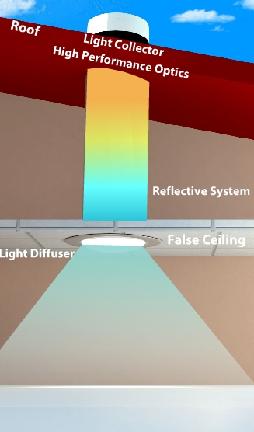
Heat Transfer:
Skyshade Lightpipe™ is designed to minimize heat transfer.
High performance light collector partially rejects mid noon sunlight.
Static air column of the pipe(Reflective System) minimizes heat transfer.
This is a property of Skyshade. It Cannot be reproduced partly or wholly without permission

Slide 20
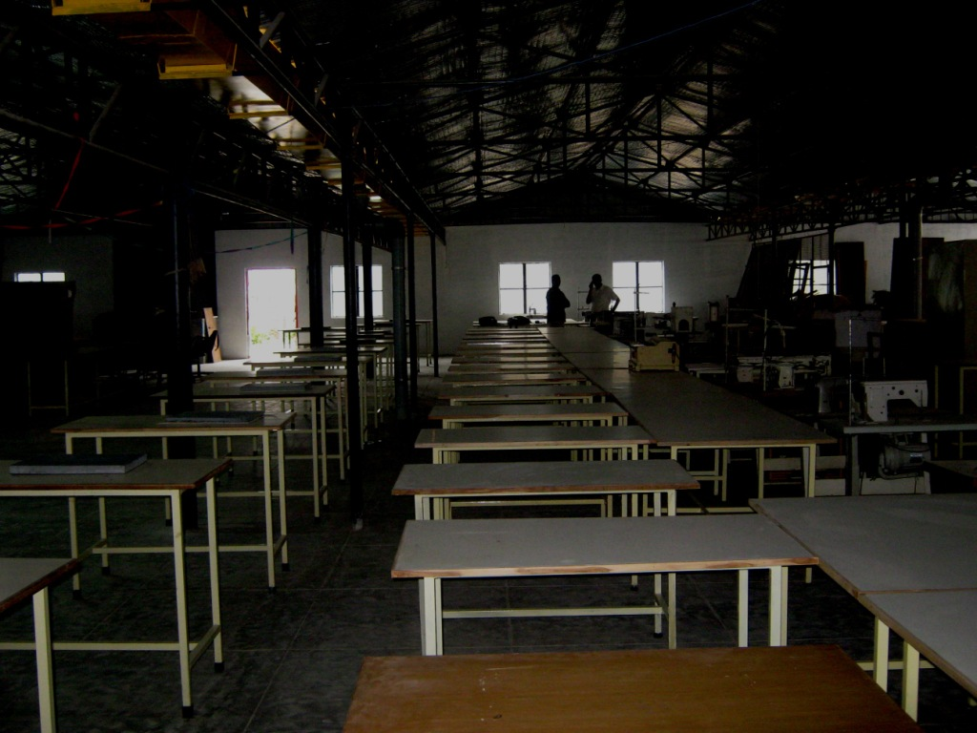
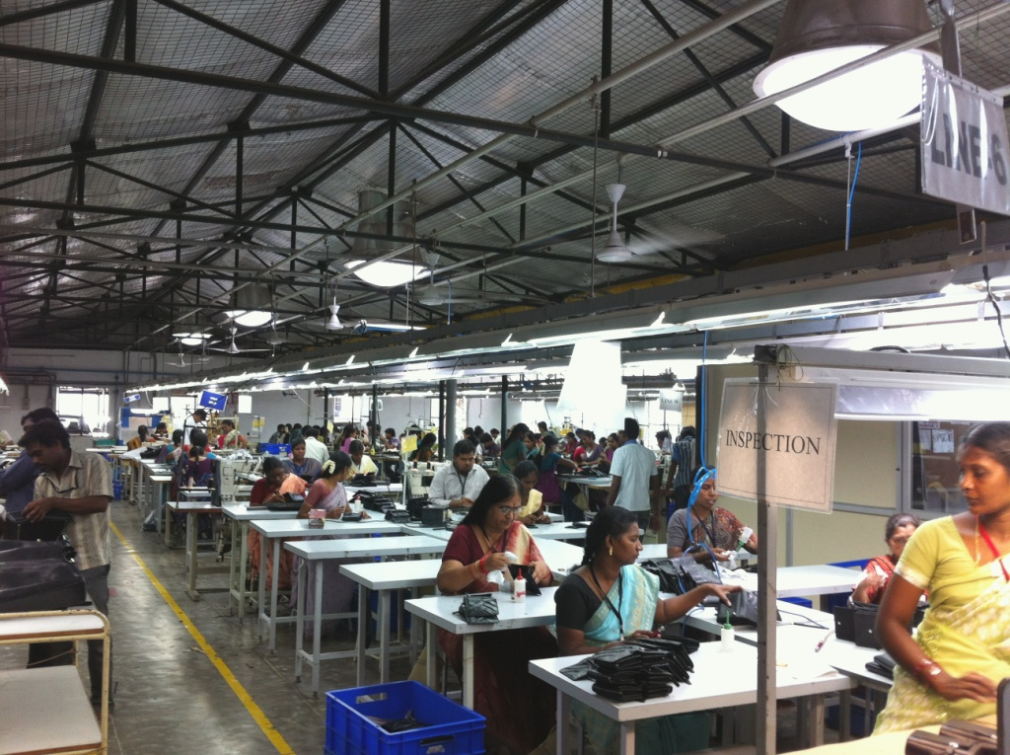
Harvesting Sunlight with out Heat
Before Lightpipe
After Lightpipe
Improved ambience & Quality of space
This is a property of Skyshade. It Cannot be reproduced partly or wholly without permission

Slide 21
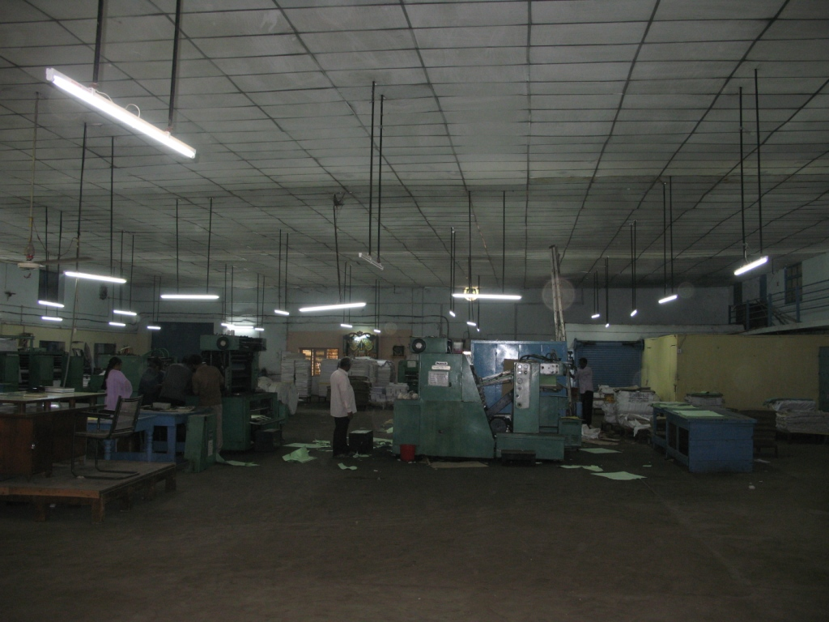
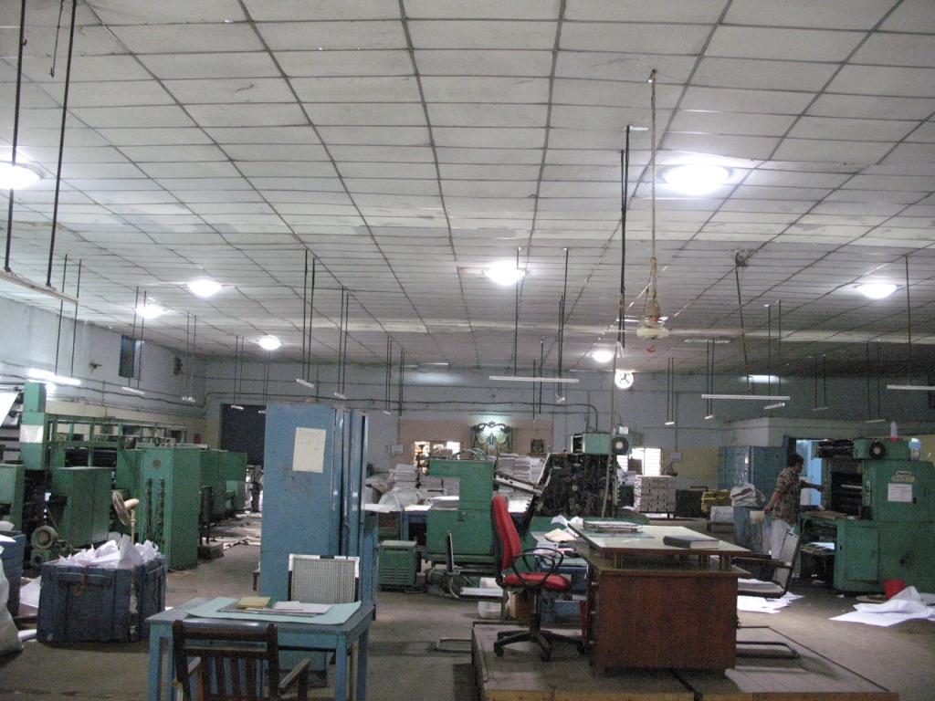
Lightpipe™ Daylighting compares with Electrical Lighting
Electrical Lighting
Energy Consumption on Daytime
Lightpipe™ Daylighting
Energy Savings
Before Lightpipe
After Lightpipe
Electrical Lighting contribute to Heat Load
25% to 30% Building Energy Consumption due to lighting
This is a property of Skyshade. It Cannot be reproduced partly or wholly without permission

Slide 22
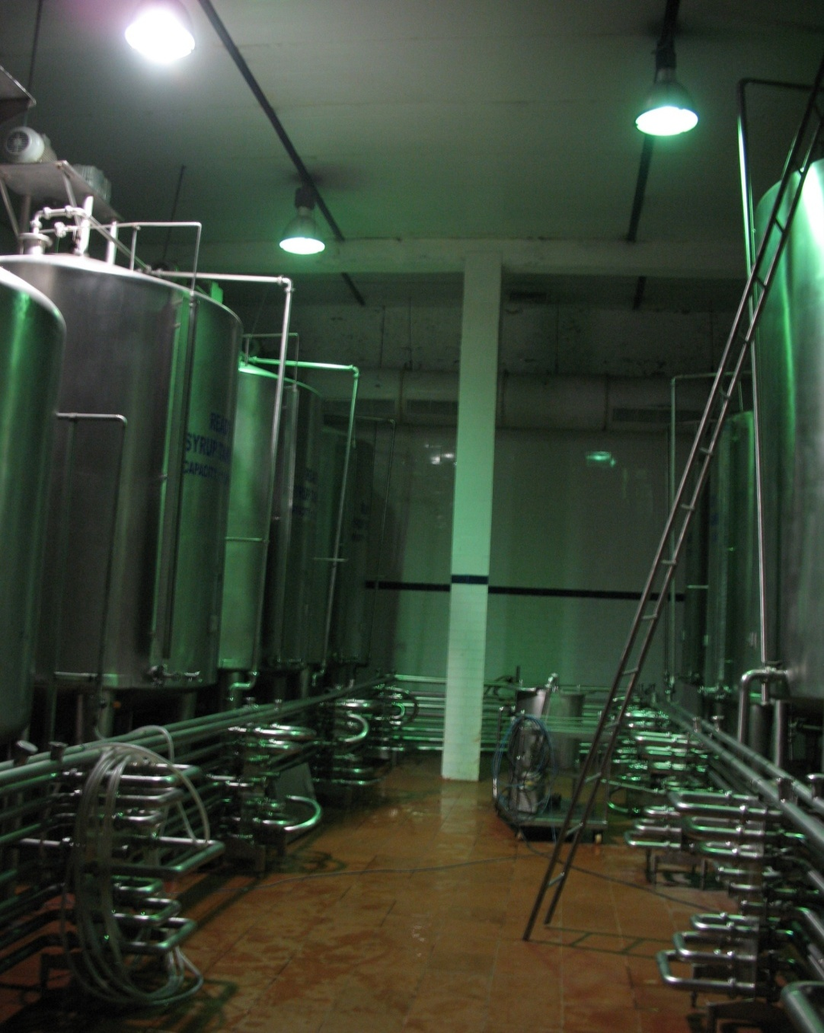
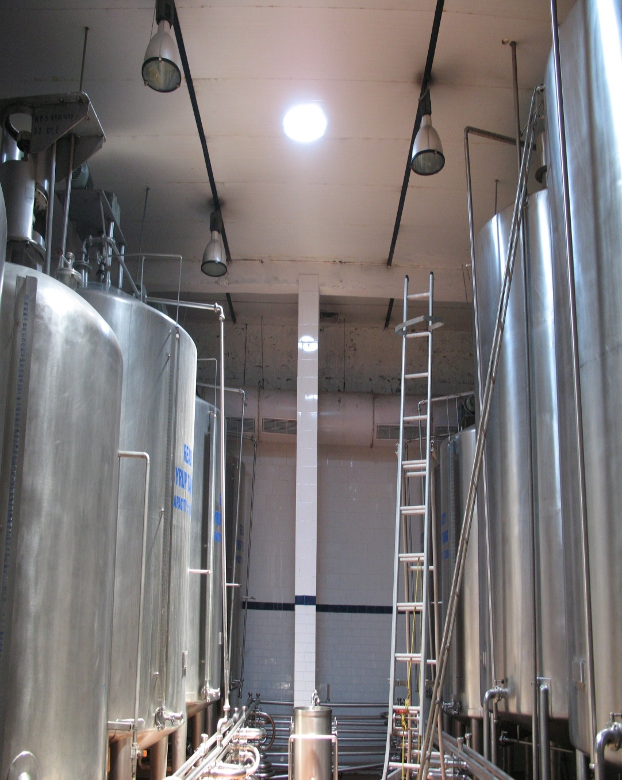
Lightpipe™ Daylighting compares with Electrical Lighting
Electrical Lighting
Lightpipe Daylighting
Superior Color rendering by Daylighting
This is a property of Skyshade. It Cannot be reproduced partly or wholly without permission

Slide 23
Lightpipe™ Sizes:
Diameter Length Recommended
750 mm Short Length
530 mm 10-12 m
400 mm 8 m
300 mm 6 m
Lightpipe™ Bends
Bends are allowed in Lightpipe™ of 45° & 90°
This is a property of Skyshade. It Cannot be reproduced partly or wholly without permission

Slide 24
This is a property of Skyshade. It Cannot be reproduced partly or wholly without permission

Slide 25
This is a property of Skyshade. It Cannot be reproduced partly or wholly without permission

Slide 26
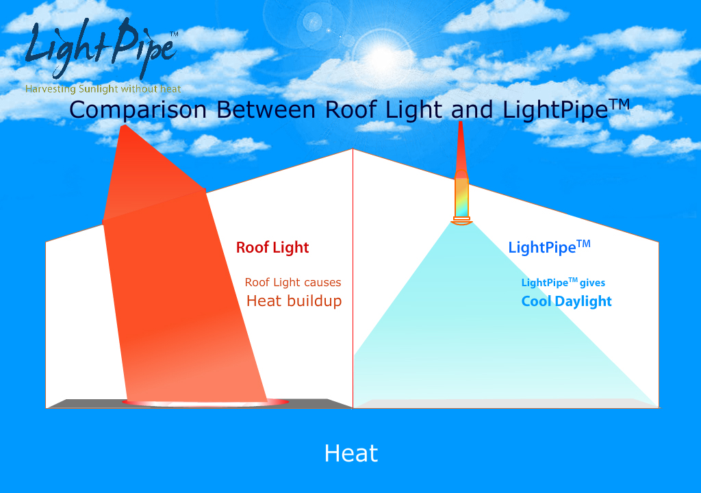
This is a property of Skyshade. It Cannot be reproduced partly or wholly without permission

Slide 27
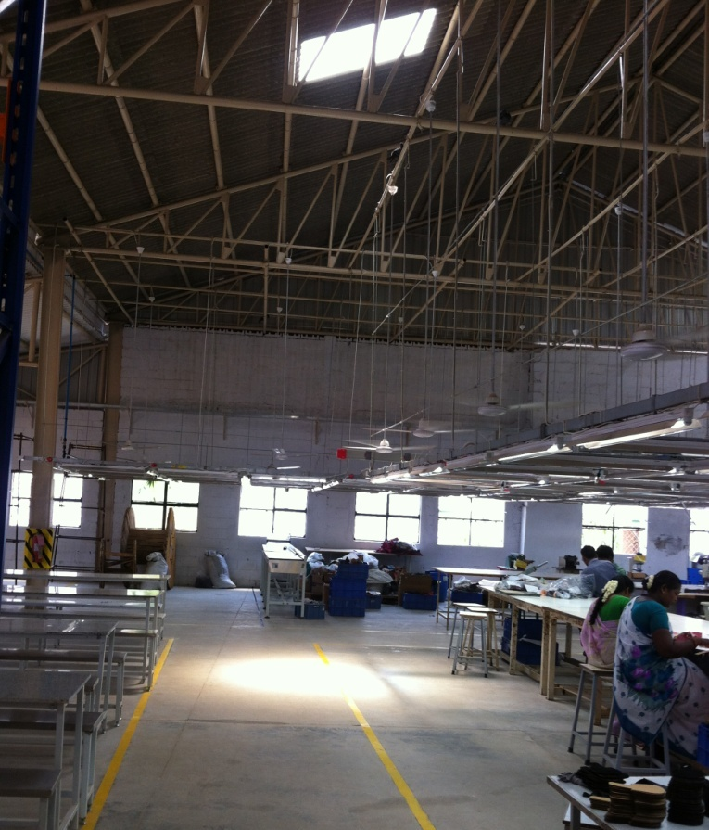
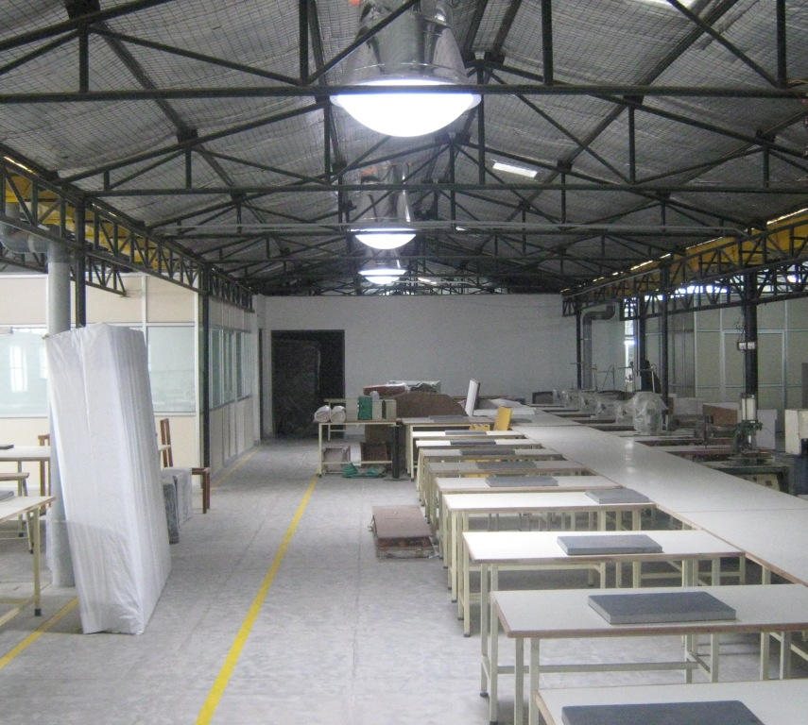
Comparison of Roof lighting with Lightpipe Daylighting
Roof Light
Heat transfer
Bright Spot
On floor
Diffused Lighting on floor
Without Heat & Bright spot
This is a property of Skyshade. It Cannot be reproduced partly or wholly without permission

Slide 28
r
This is a property of Skyshade. It Cannot be reproduced partly or wholly without permission

Slide 29
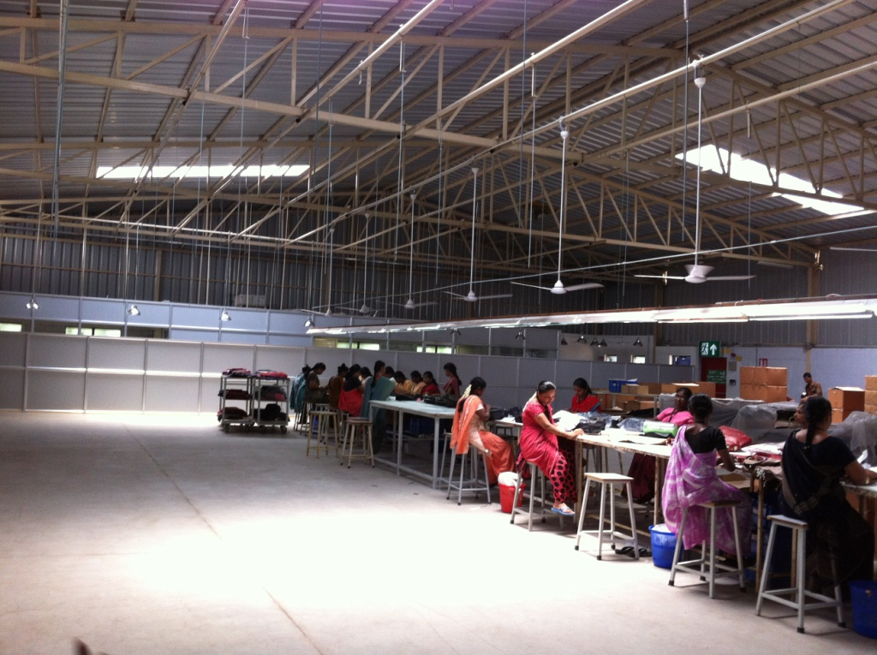
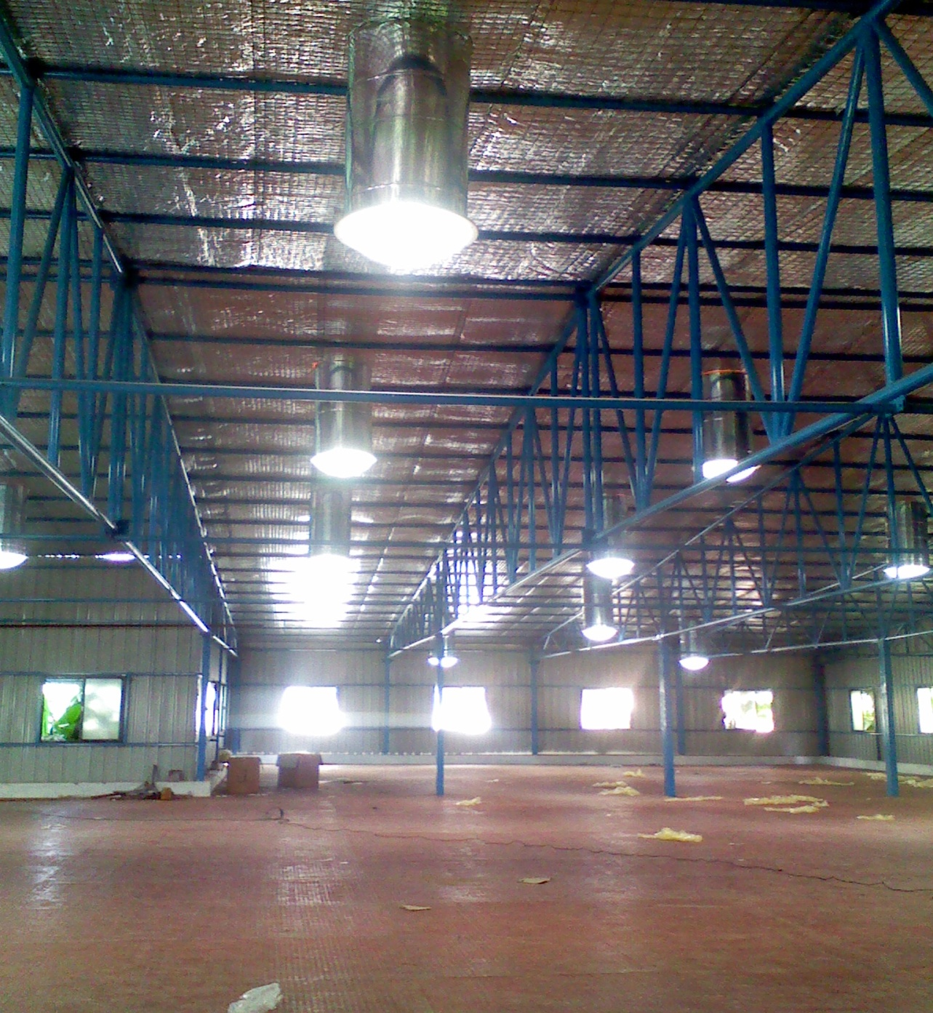
Comparison of Roof lighting with Lightpipe Daylighting
Roof Light
Non Uniform
Lighting
Uniform Lighting
without Bright spot
Bright Spot
This is a property of Skyshade. It Cannot be reproduced partly or wholly without permission

Slide 30
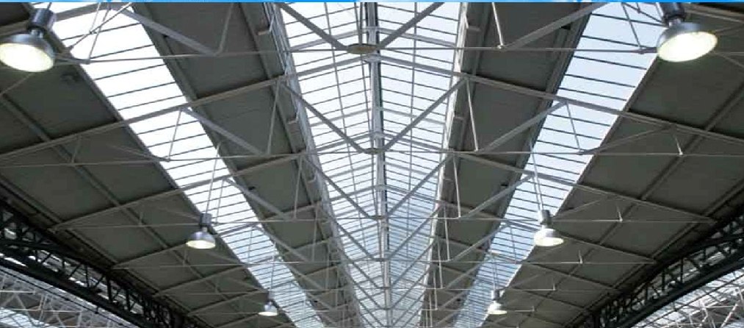
Area usages: Roof light vs Lightpipe
8 to 10% of Roof area is used for
Roof lights or Skylights.
Lightpipe 1.5% of Roof area is used
to deliver the same light.
This is a property of Skyshade. It Cannot be reproduced partly or wholly without permission

Slide 31
This is a property of Skyshade. It Cannot be reproduced partly or wholly without permission

Slide 32
This is a property of Skyshade. It Cannot be reproduced partly or wholly without permission

Slide 33
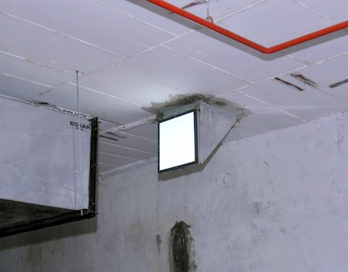
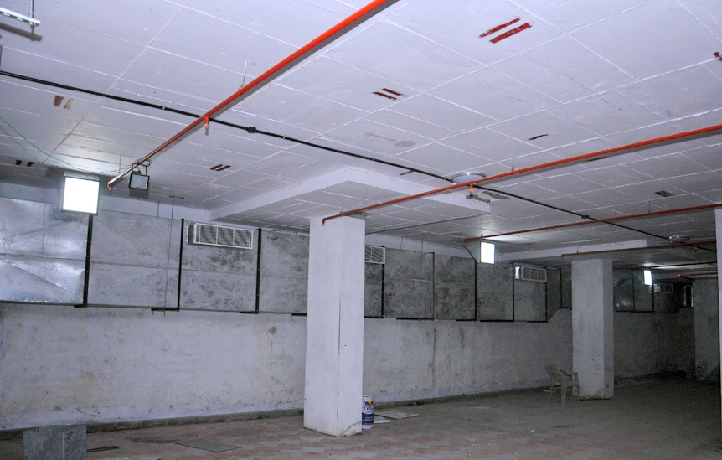
Lightpipe Daylighting in Basement
Lightpipe™ Daylighting in Building Basement
Lightpipe™ Daylighting in Building Basement
This is a property of Skyshade. It Cannot be reproduced partly or wholly without permission

Slide 34
Lightpipe™ - Side wall Installation
This is a property of Skyshade. It Cannot be reproduced partly or wholly without permission

Slide 35
This is a property of Skyshade. It Cannot be reproduced partly or wholly without permission

Slide 36
Payback Calculations
Payback calculation is worked out in comparison to Electrical Lighting
Energy Savings:
Typical 750 mm diameter Lightpipe™ lumen output is 20,000 lumens.
Electrical lighting wattage equivalent to 750mm diameter Lightpipe™ - 475w
Electrical Energy savings per year is
1 Lightpipe * 0.475 kw * 10 hrs/day * 365 days * Rs. 7.00/kwh
= Rs. 12,136.25
Maintenance cost savings: Considering bulb replacement & other costs.
Total w * Rs/w = 475 * Rs. 5
= Rs.2375
This is a property of Skyshade. It Cannot be reproduced partly or wholly without permission

Slide 37
Payback Calculations
Year | Investment (A) Rs. | Electrical Energy Savings (B) Rs (10% hike in every year) | Maintenance Cost Savings Rs. (C) (10% hike in every year) | Income tax depreciation 80% Rs. (D) | Balance Rs. A-(B+C+D)
1 | 30,000 | 12,136 | 2,375 | 8,400 | 7,089
2 | 7,089 | 12,350 | 2,612 | - | -(8872)
Payback Period: 1Year 5 Months
Note: Solar Lightpipe™ being a Solar energy device qualifies for 80% depreciation in 1st year.
This is a property of Skyshade. It Cannot be reproduced partly or wholly without permission

Slide 38
Lightpipe™ Lumen Output
Size of the Lightpipe | Lumen Output approximately | Area Coverage approximately
750 mm | 22,000 lumens | 1000Sft
530 mm | 12,000 lumens | 500Sft
400 mm | 8,000 lumens | 350Sft
300 mm | 4,000 lumens | 150Sft
Lumen output is calculated for clear sky conditions
when ambient light is 1,00,000 lux.

Slide 39
Energy Savings
Size of the Lightpipe | Equivalent Wattage of Electrical Lighting | Electrical Energy Savings | Area Coverage Approximately
750 mm | 475 w | 1800kwhs | 1000Sft
530 mm | 300 w | 1100kwhs | 500Sft
400 mm | 180 w | 650kwhs | 350Sft
300 mm | 90 w | 320kwhs | 150Sft
Note: Solar Lightpipe™ being a Solar energy device qualifies
for 80% depreciation in 1st year.

Slide 40
Daylight in Green Buildings
The LEED * Green building rating system is a voluntary system where in the environmental performance of whole building is evaluated.
Skyshade Light pipes can impact the following categories :
Energy & Atmosphere-Reduction of design energy cost and energy performance optimization.
Size of the Lightpipe | Equivalent Wattage of Electrical Lighting | Lumen Output | Electrical Energy Savings | Area Coverage approximately
750 mm | 475 w | 22,000 lumens | 1800kwhs | 1000Sft
530 mm | 300 w | 12,000 lumens | 1100kwhs | 500Sft
400 mm | 180 w | 8,000 lumens | 650kwhs | 350Sft
300 mm | 90 w | 4,000 lumens | 320kwhs | 150Sft

Slide 41
Maintenance:
Light pipes are optic based system which continuously collect light during day.
To help them collect and provide better performance, they need to clean the top light collector Periodically from dust.
Simple soft cloth with plain water (if required) is what it all requires monthly basis.
This is a property of Skyshade. It Cannot be reproduced partly or wholly without permission

Slide 42
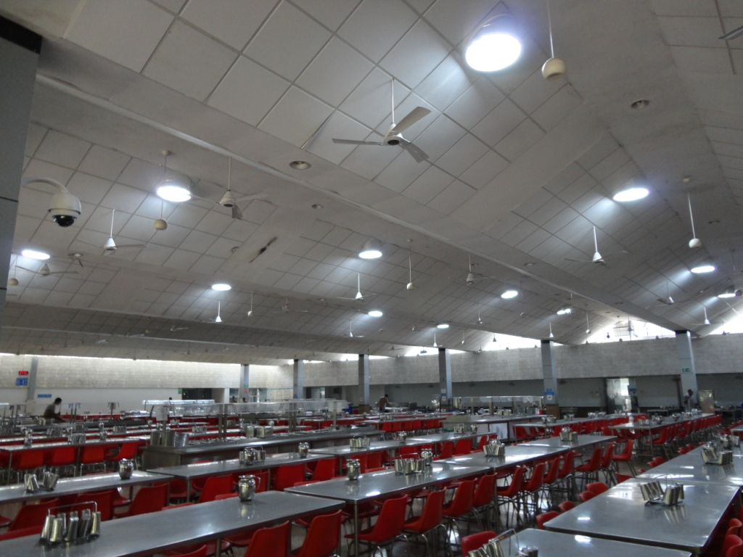
Industrial application
This is a property of Skyshade. It Cannot be reproduced partly or wholly without permission

Slide 43
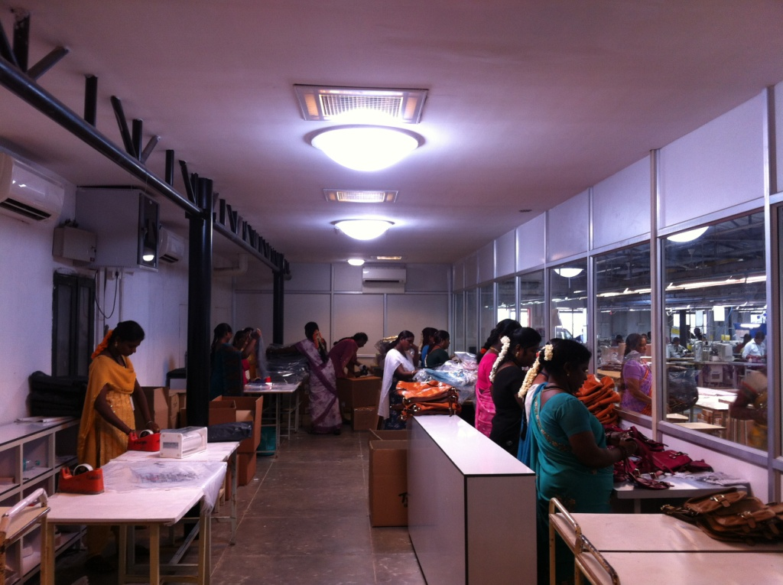
Industrial application
This is a property of Skyshade. It Cannot be reproduced partly or wholly without permission

Slide 44
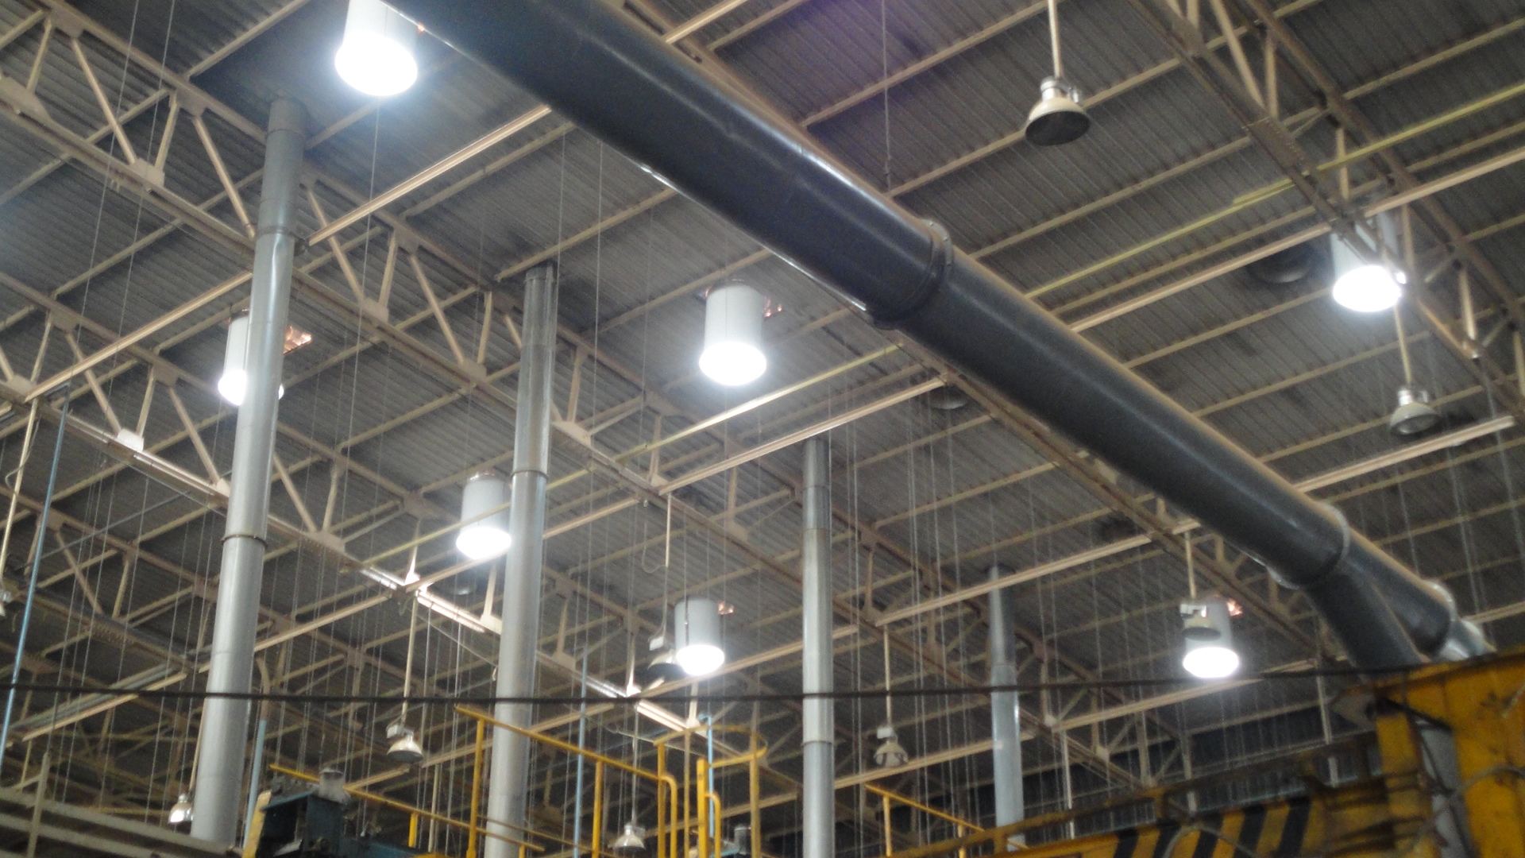
Industrial application
This is a property of Skyshade. It Cannot be reproduced partly or wholly without permission

Slide 45
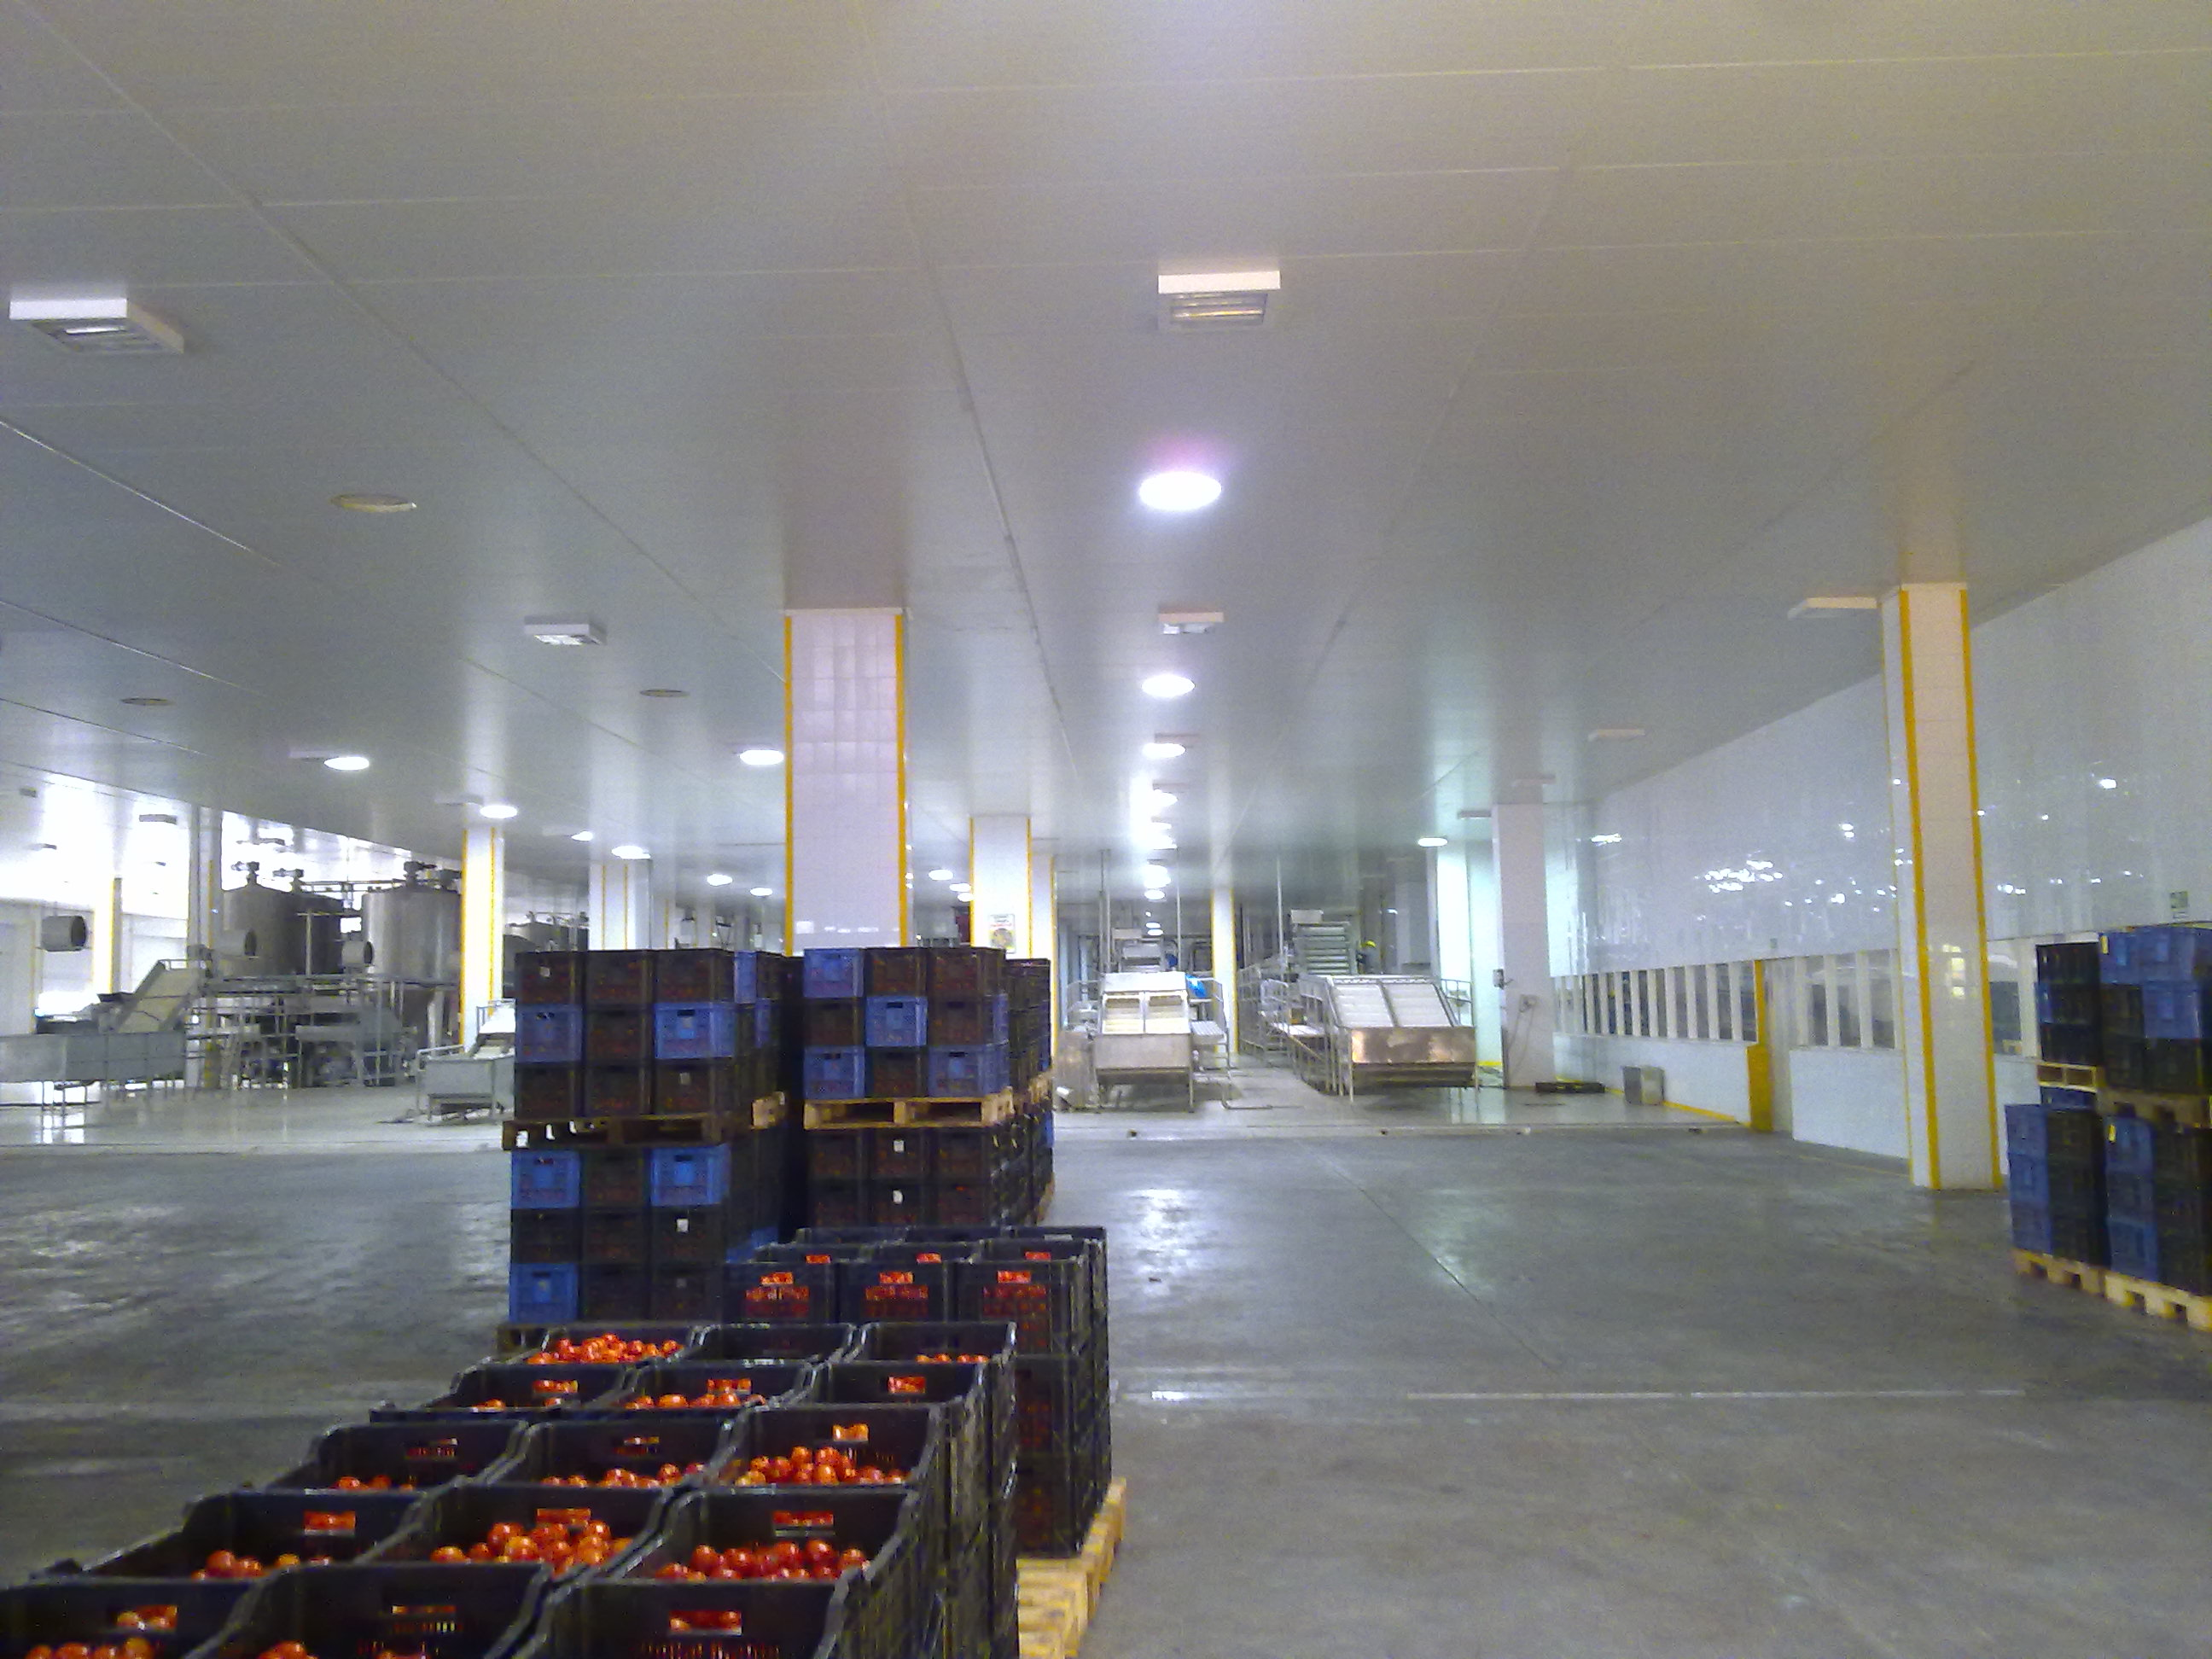
Industrial application
This is a property of Skyshade. It Cannot be reproduced partly or wholly without permission

Slide 46
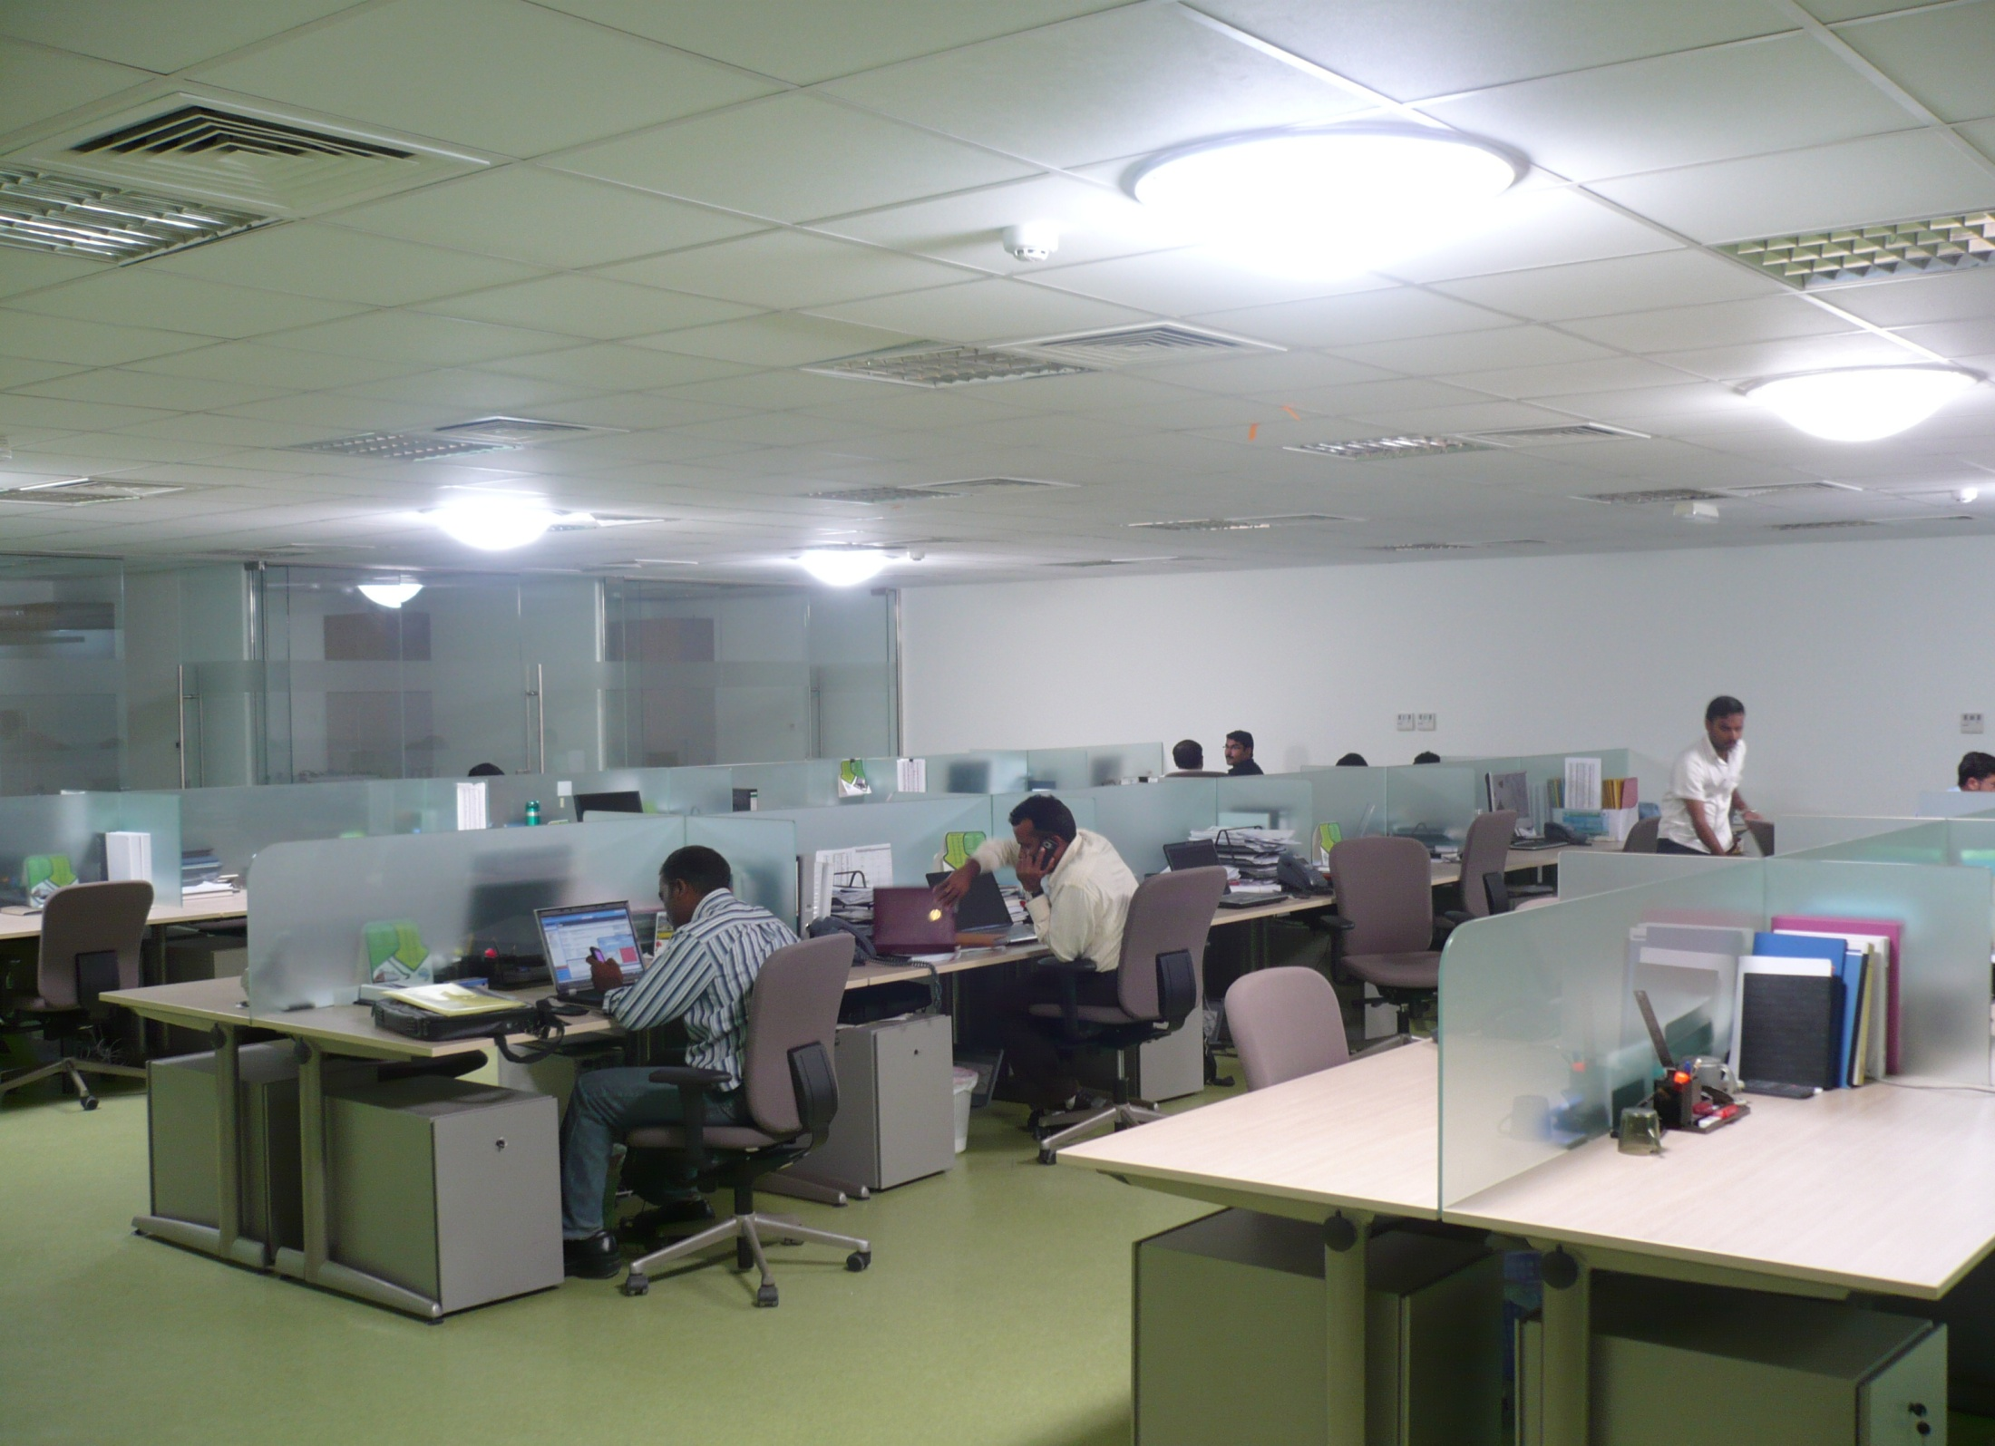
Office application
This is a property of Skyshade. It Cannot be reproduced partly or wholly without permission

Slide 47
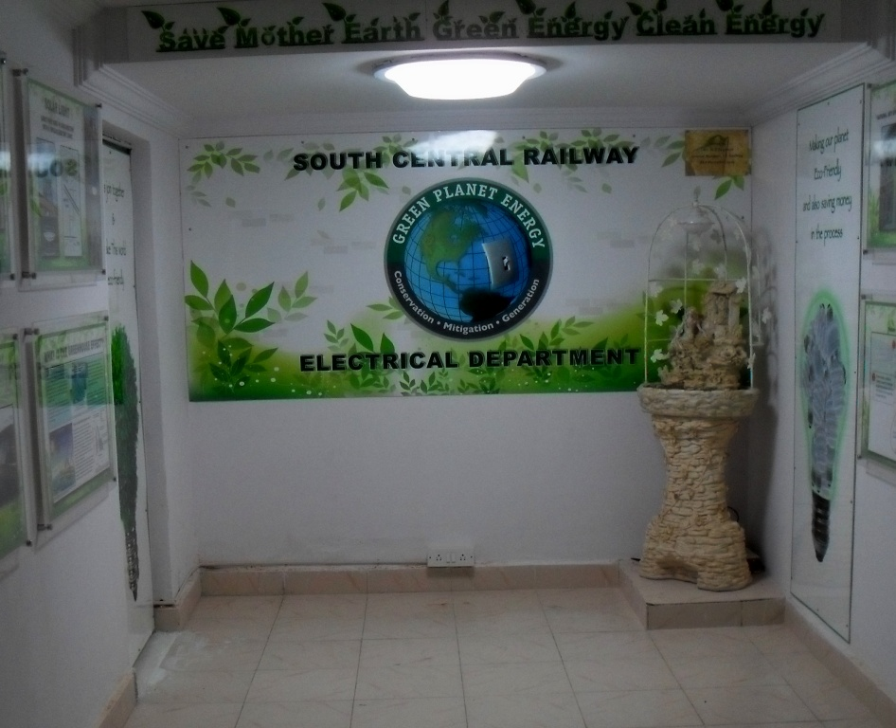
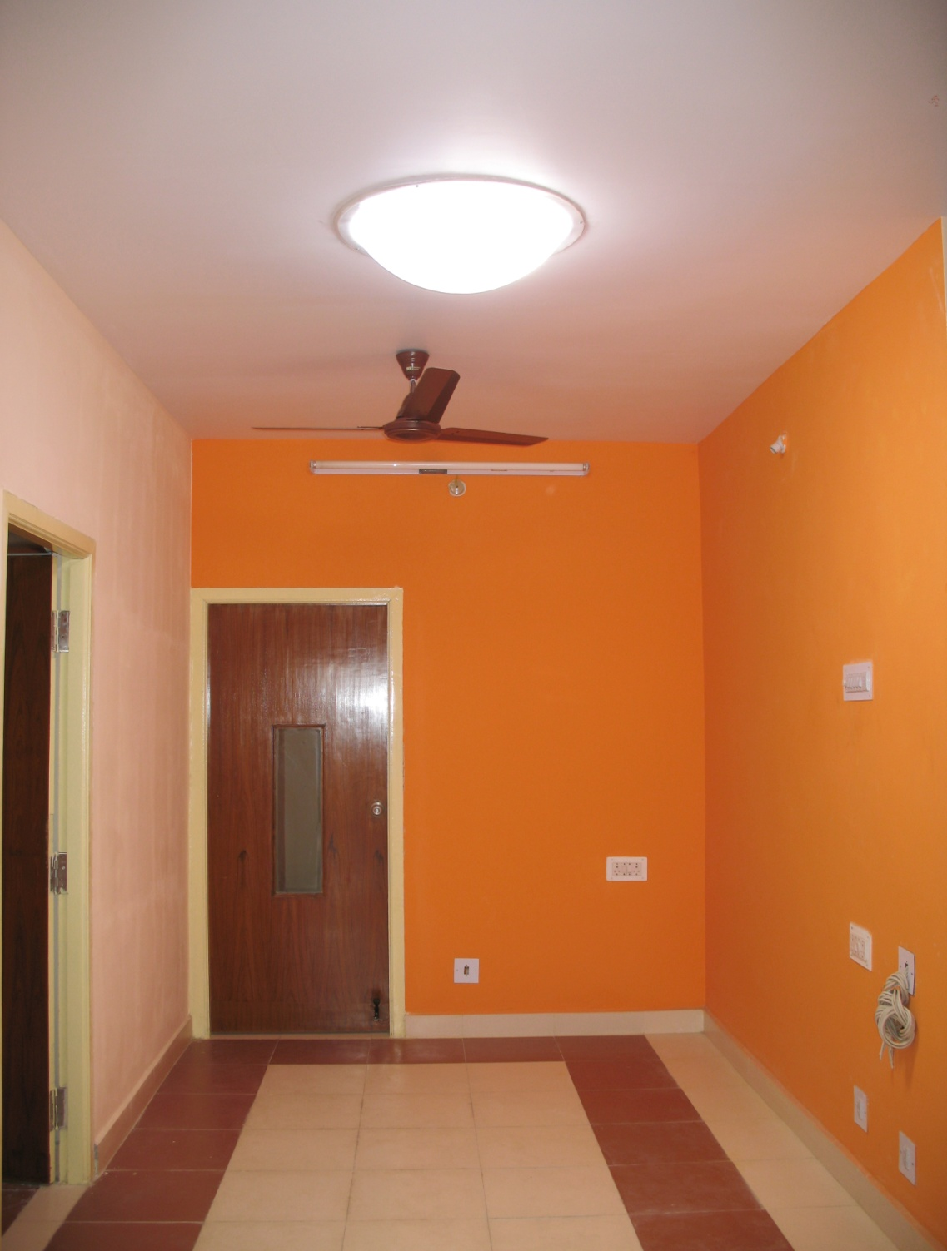
Office application
Office application
This is a property of Skyshade. It Cannot be reproduced partly or wholly without permission

Slide 48
Daylight Dimming Arrangement
“Ability to control sunlight delivered into building space is key to Human Comfort”
Light pipes are equipped with dimmer arrangement - motorized control
to dim the Daylight.
Because you don’t need 100% of the light 100% of the time, the innovative
Skyshade Lightpipe Daylighting Dimmer easily controls the amount of
daylight entering a room with the convince of a switch.
Applications: Areas of privacy, Conference rooms &
Office areas require the Dimming arrangement.
This is a property of Skyshade. It Cannot be reproduced partly or wholly without permission

Slide 49
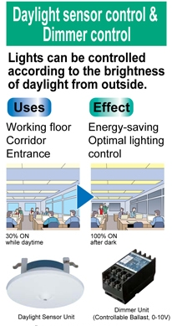
Lightpipe™ Daylighting integration with Electrical lighting:
“Studies on Daylighting systems show that 30-50% more energy saving potential can be realized when Daylighting is fully integrated with Electrical lighting.”
Skyshade provides complete solution of controls for Electrical lighting to switch off them when day light is available.
In existing buildings where LightPipes are installed,
the electrical lights can be simply switched on/off by Day light sensors depending on daylight provided in a space.
This is a property of Skyshade. It Cannot be reproduced partly or wholly without permission

Slide 50
Lightpipe™ Daylighting integration with Electrical lighting:
In electrical lighting with dimmable hardware more precise control can be done.
New buildings where light pipes are being planned, It is recommended to have dimmable Electrical lighting systems and be integrated with light pipes- Day lighting system.
This arrangement ensures that irrespective of ambient light constant light flux is made available to building occupants.
This is a property of Skyshade. It Cannot be reproduced partly or wholly without permission

Slide 51
Lightpipe Integration with Electrical Lighting Flash Animation
This is a property of Skyshade. It Cannot be reproduced partly or wholly without permission

Slide 52
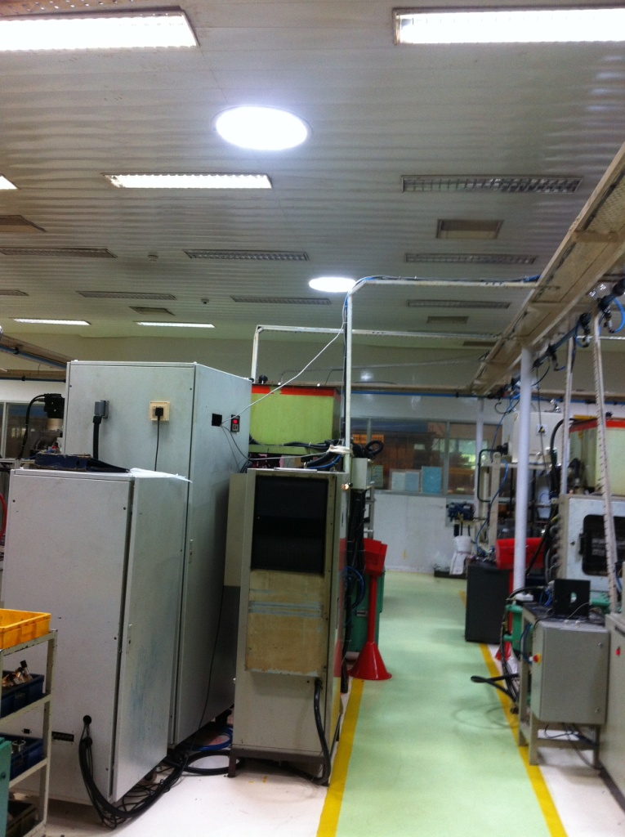
Integration of Daylighting with Electrical Lighting
Energy savings are proportional to the reduction of use of electric lighting, not to the amount of daylight in the room.
Given the high average luminous efficacy less total energy is required to achieve a given illuminance in a room with daylight than with electric light.
This is a property of Skyshade. It Cannot be reproduced partly or wholly without permission

Slide 53
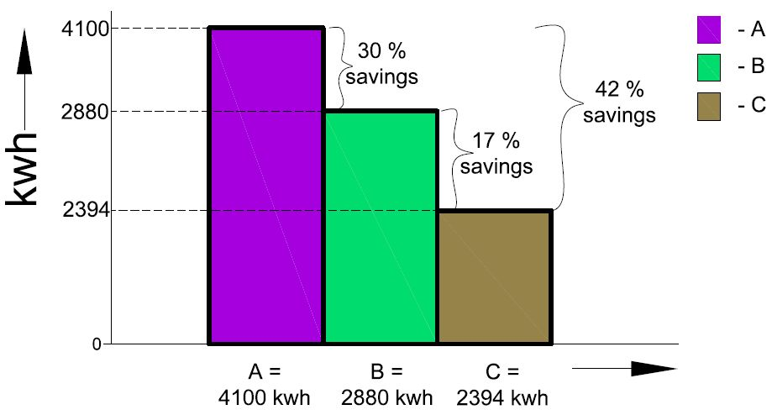
For 24 hours operating production floors:
Annual Electrical energy consumption for 400 watt Metal halide lamp – 4100 kwh.
Annual Electrical energy consumption with Electrical light & equivalent Daylight availability-2880 kwh(30%).
Annual Electrical energy consumption with Electrical light,
Daylight & controls-2394kwh (42%).
This is a property of Skyshade. It Cannot be reproduced partly or wholly without permission

Slide 54
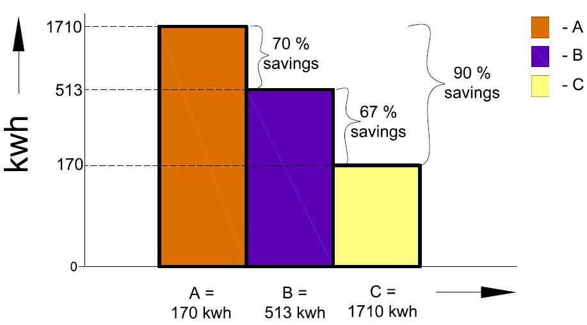
For 10hrs operating cycle spaces
Electrical energy consumption of 400w Metal halide lamp for 24hrs/10hrs cycle.
Electrical energy consumption of 400w Metal halide lamp with
equivalent Daylight.
C. Electrical energy consumption of 400w Metal halide lamp,
Daylight & Controls.
This is a property of Skyshade. It Cannot be reproduced partly or wholly without permission

Slide 55
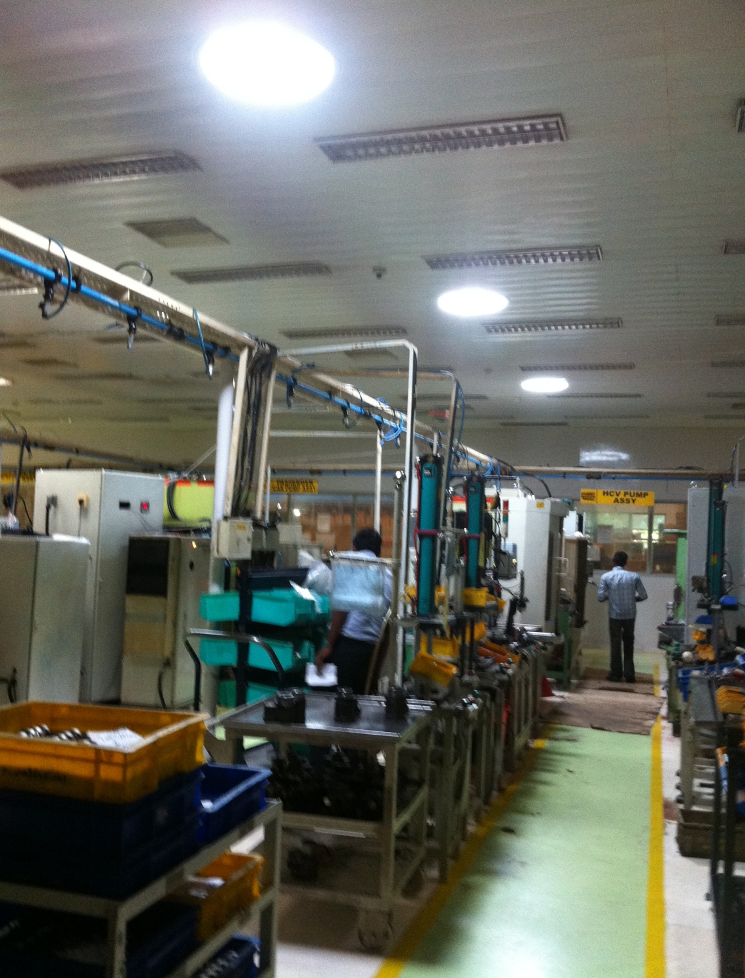
Lightpipe Daylighting
Lightpipe Daylighting integrated
with Electrical lighting
It is commonly observed that Electrical lighting systems switched on even though Daylight is amply provided.
This is a property of Skyshade. It Cannot be reproduced partly or wholly without permission

Slide 56
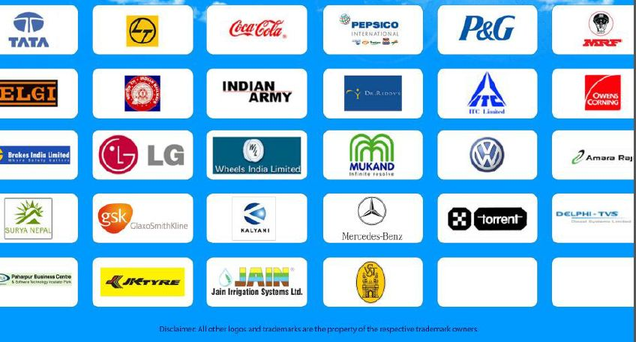
Clients
This is a property of Skyshade. It Cannot be reproduced partly or wholly without permission

Slide 57
Contact Info
Skyshade Daylights
H.No: 6-3-1216/141,Methodist Colony, Kundanbagh Begumpet, Hyderabad-500016, Andhra Pradesh, India
Phone: +9140 66623392/93
Website: http://www.skyshade.in/
This is a property of Skyshade. It Cannot be reproduced partly or wholly without permission

